Slide 1



Understanding Organizations As Customers

Slide 2
LEARNING OBJECTIVES (LO) AFTER READING CHAPTER 5, YOU SHOULD BE ABLE TO:
1. Distinguish among industrial, reseller, and government organizational markets.
2. Describe the key characteristics of organizational buying that make it different from consumer buying.
3. Explain how buying centers and buying situations influence organizational purchasing.
4. Recognize the importance and nature of online buying in industrial, reseller, and government organizational markets.

Slide 3


BUYING IS MARKETING, TOO! PURCHASING PUBLICATION PAPER FOR JC PENNEY
JC Penney
Website

Slide 4

BUSINESS-TO-BUSINESS MARKETING AND ORGANIZATIONAL BUYERS
Business-to-Business Marketing
Organizational Buyers
Industrial Markets (Industrial Firms)
Reseller Markets (Resellers)
Wholesalers
Retailers
Government Markets (Government Agencies)
NASA

Slide 5
MEASURING DOMESTIC AND GLOBAL INDUSTRIAL, RESELLER, AND GOVERNMENT MARKETS
North American Industry Classification System (NAICS)
North American Free Trade Agreement (NAFTA)
NAICS
Web Site
NAFTA
Web Site

Slide 6
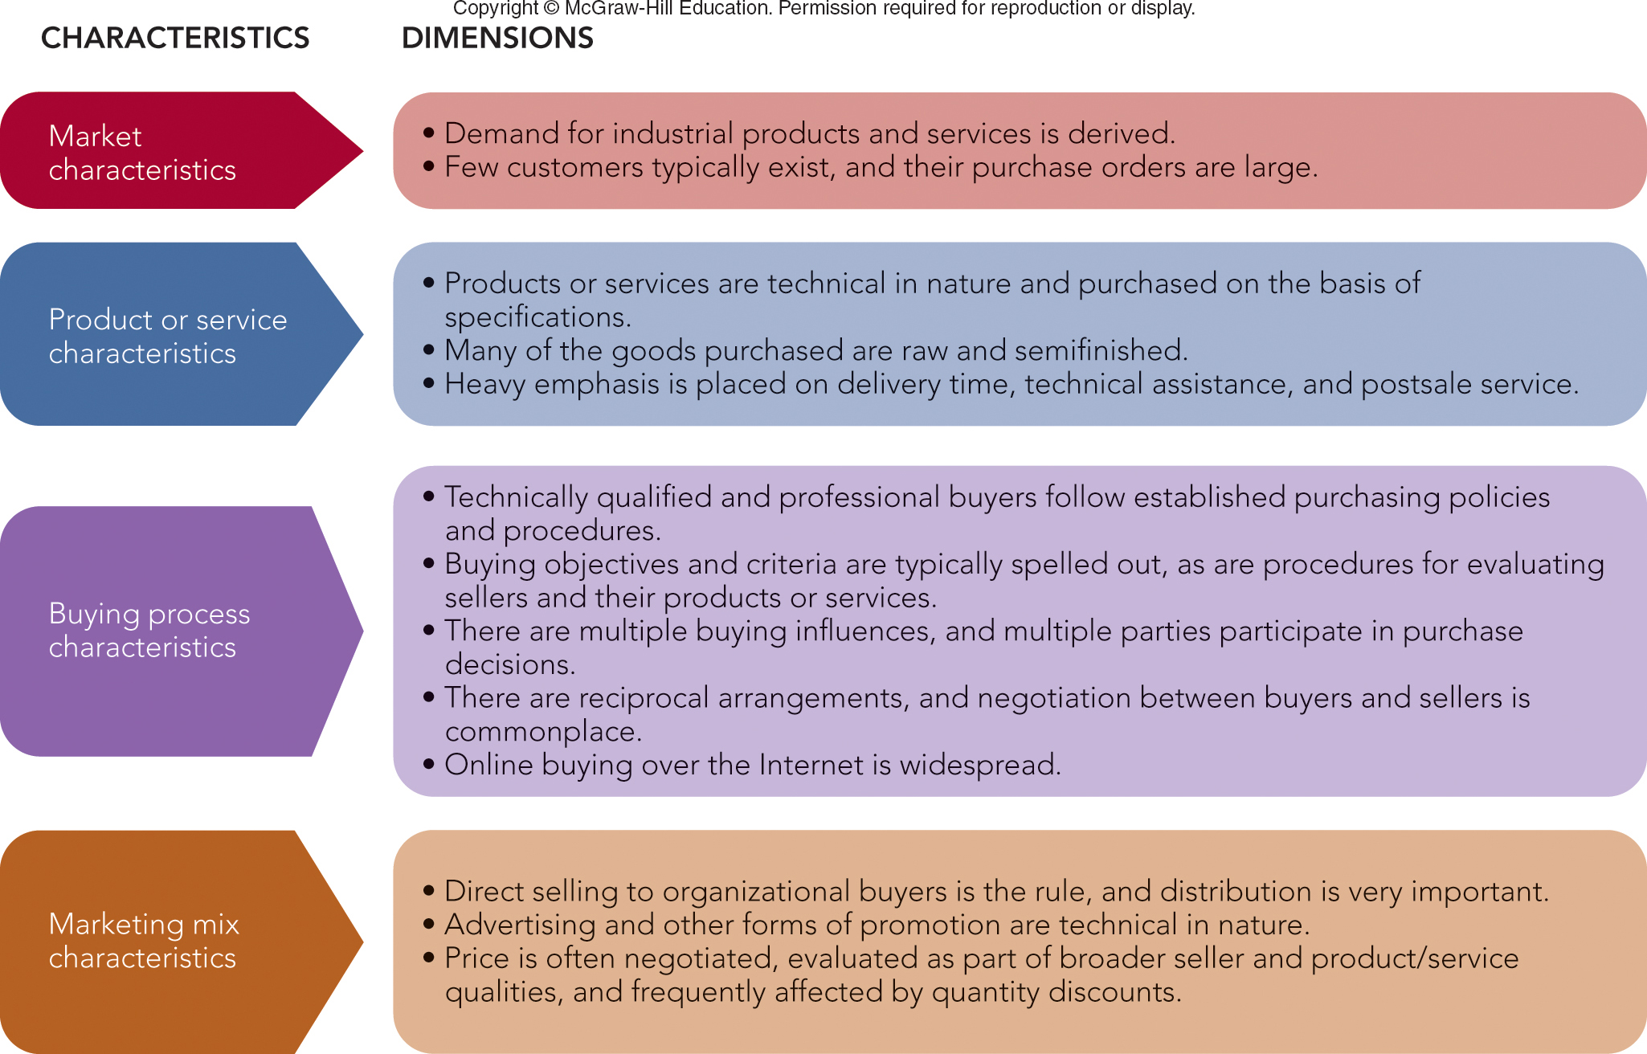
FIGURE 5-1 Key characteristics and dimensions of organizational buying behavior.
Jump to Appendix 1 long image description

Slide 7
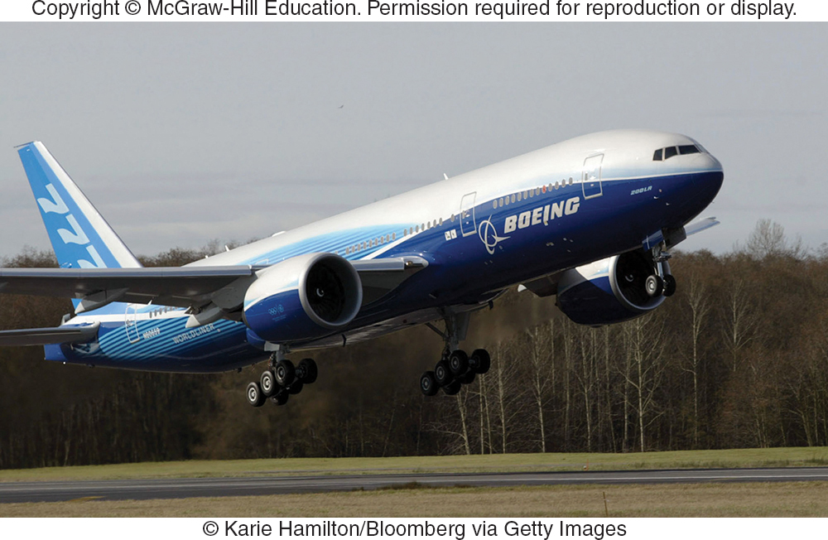
ORGANIZATIONAL BUYING DEMAND CHARACTERISTICS
Derived Demand
Size of Order or Purchase
Number of Potential Buyers
Organizational Buying Objectives
Profits
Women/Minority Suppliers/Vendors
Efficiency
Environment/Sustainability

Slide 8

CHARACTERISTICS OF ORGANIZATIONAL BUYING ORGANIZATIONAL BUYING CRITERIA
LO 5-2
Organizational Buying Criteria
Supplier Development

Slide 9
FIGURE 5-A Key Organizational Buying Criteria
Profit Responsibility
Warranty/Claim Policies
Technical Capabilities
Price
Quality Specifications
Delivery Schedules
Past Performance
Product Facilities/Capacity
Jump to Appendix 2 long image description

Slide 10
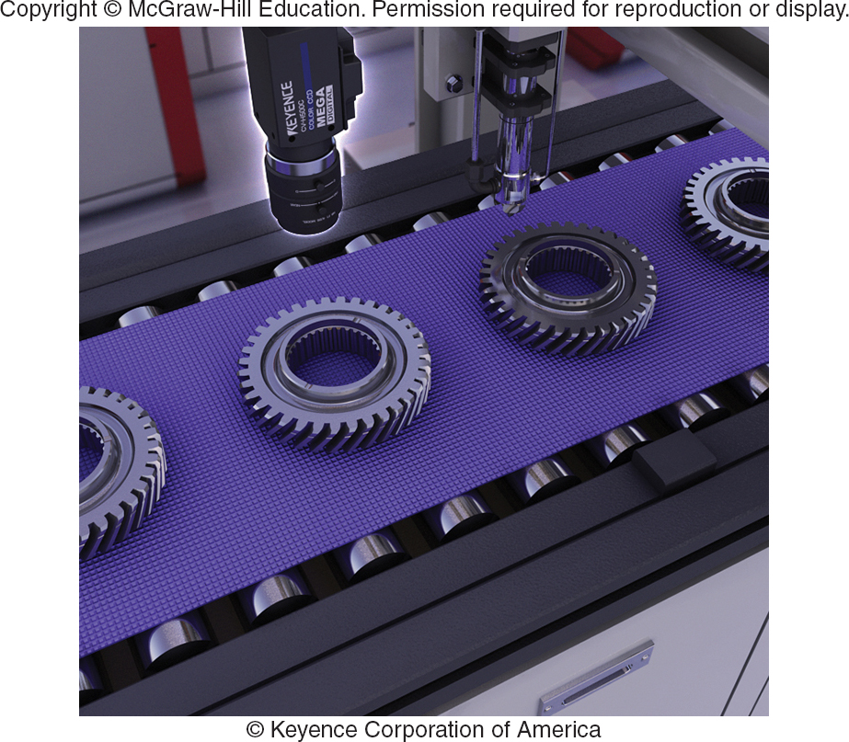
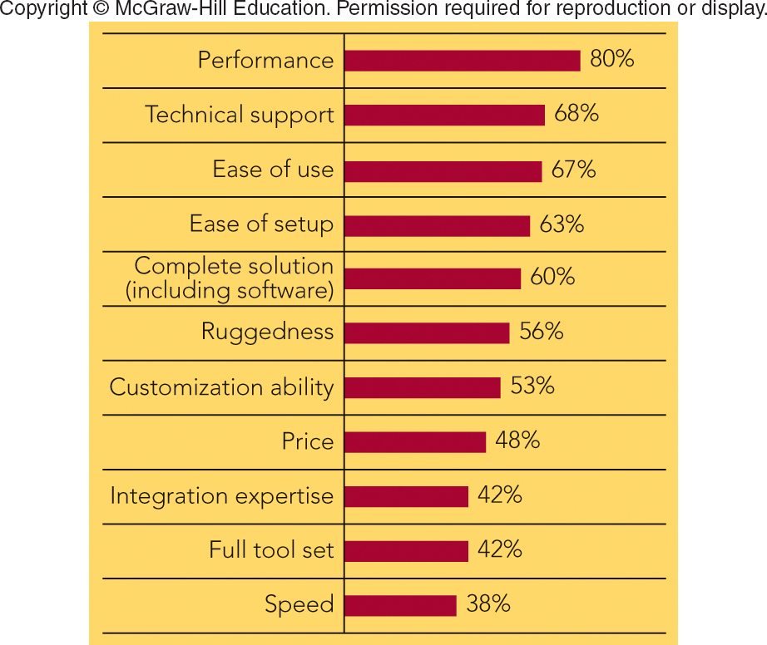
FIGURE 5-2 Product and supplier selection criteria for buying machine vision equipment emphasize factors other than price.
Machine vision inspection camera used in auto industry to perform a gear inspection
Percentage of machine vision buyers citing individual selection criteria as important when making supplier decision
Jump to Appendix 3 long image description

Slide 11
CHARACTERISTICS OF ORGANIZATIONAL BUYING BUYER-SELLER RELATIONSHIPS & SUPPLY PARTNERSHIPS
Reciprocity
Supply Partnership
Sustainable Procurement – To Benefit the Environment

Slide 12

MARKETING MATTERS Milsco Manufacturing—Delivering a Great Ride for Customers’ Seats
3 Million Seats
200 Unique Variations
84-Year Partnership with Harley-Davidson
100 New Products/Year to Meet Customer Requirements
Milsco Website

Slide 13
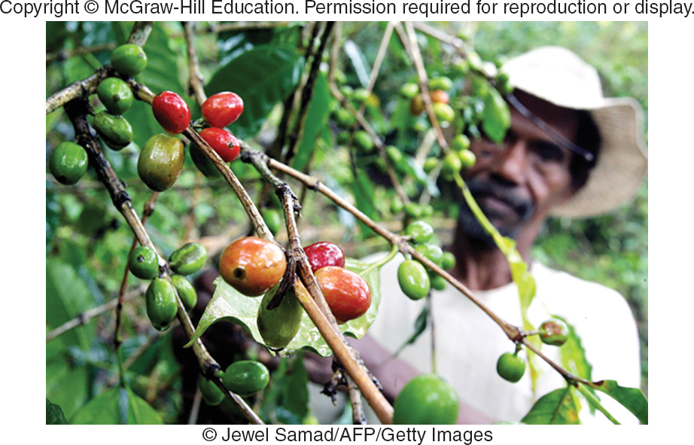
MAKING RESPONSIBLE DECISIONS Sustainable Procurement for Sustainable Growth
Starbucks Is a Leader in Sustainable Procurement
Coffee Growers in 20 Countries
Fair Price for Beans
Ecologically Sound Growing
Starbucks
Sustainability

Slide 14
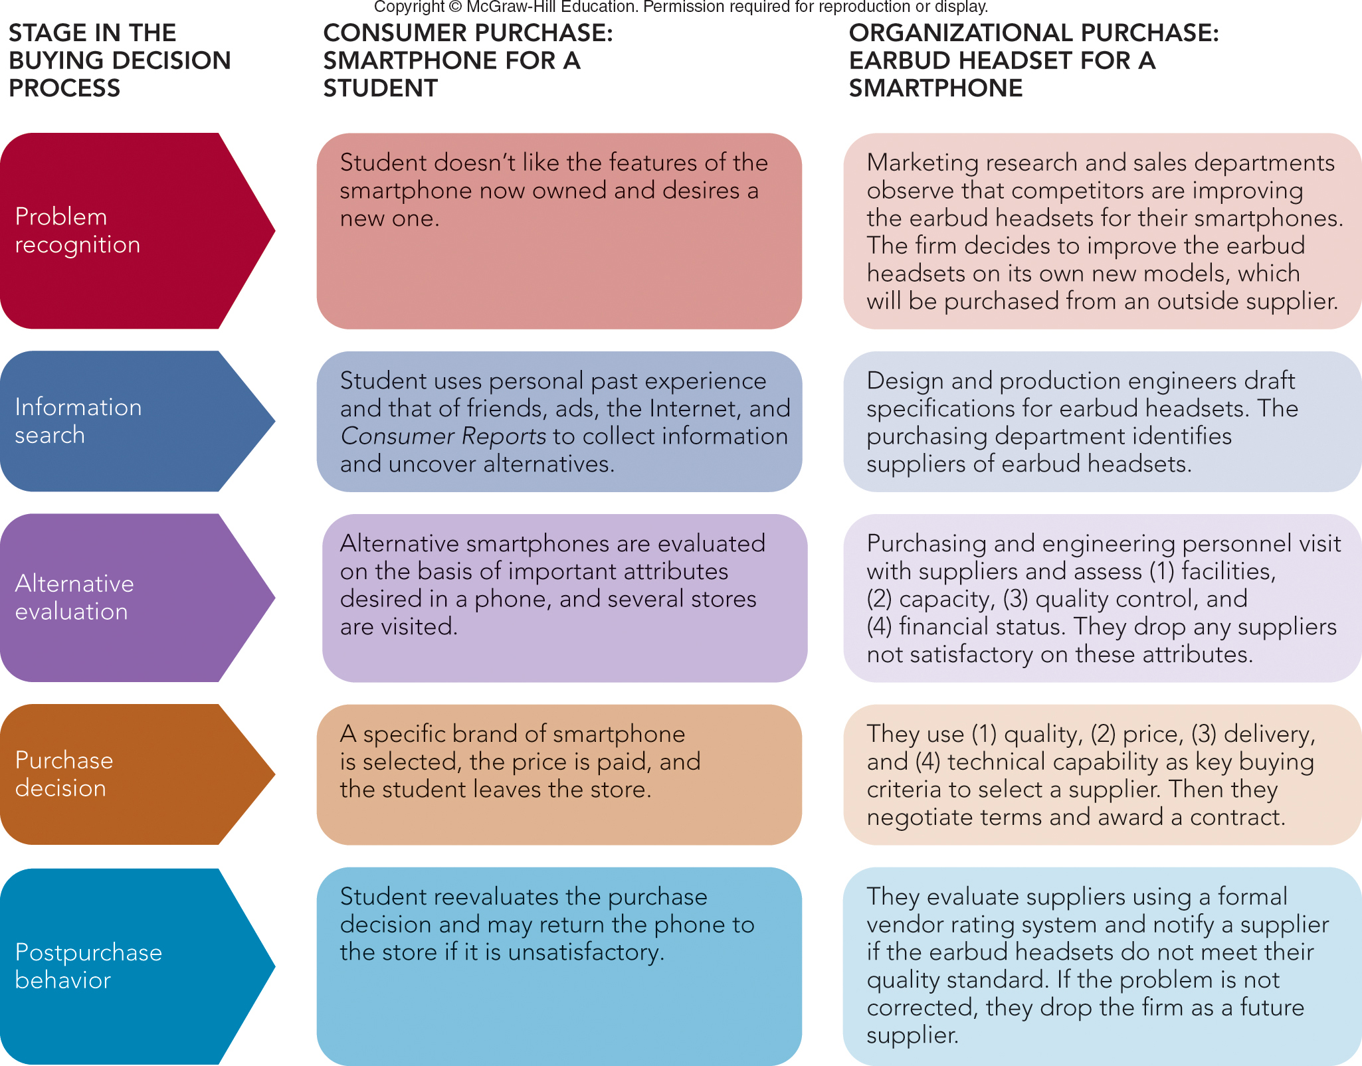
FIGURE 5-3 Comparing the stages in a consumer and organizational purchase decision process.
Jump to Appendix 4 long image description

Slide 15

ORGANIZATIONAL BUYING PROCESS AND THEY BUYING CENTER
Buying Center
Buying Committee
People in the Buying Center
Roles in the Buying Center
Users
Influencers
Buyers
Deciders
Gatekeepers

Slide 16
CHARACTERISTICS OF ORGANIZATIONAL BUYING THE BUYING CENTER
Number of People in Buying Center Depends on the Buying Situation
Buy Classes
New Rebuy
Straight Rebuy
Modified Rebuy

Slide 17
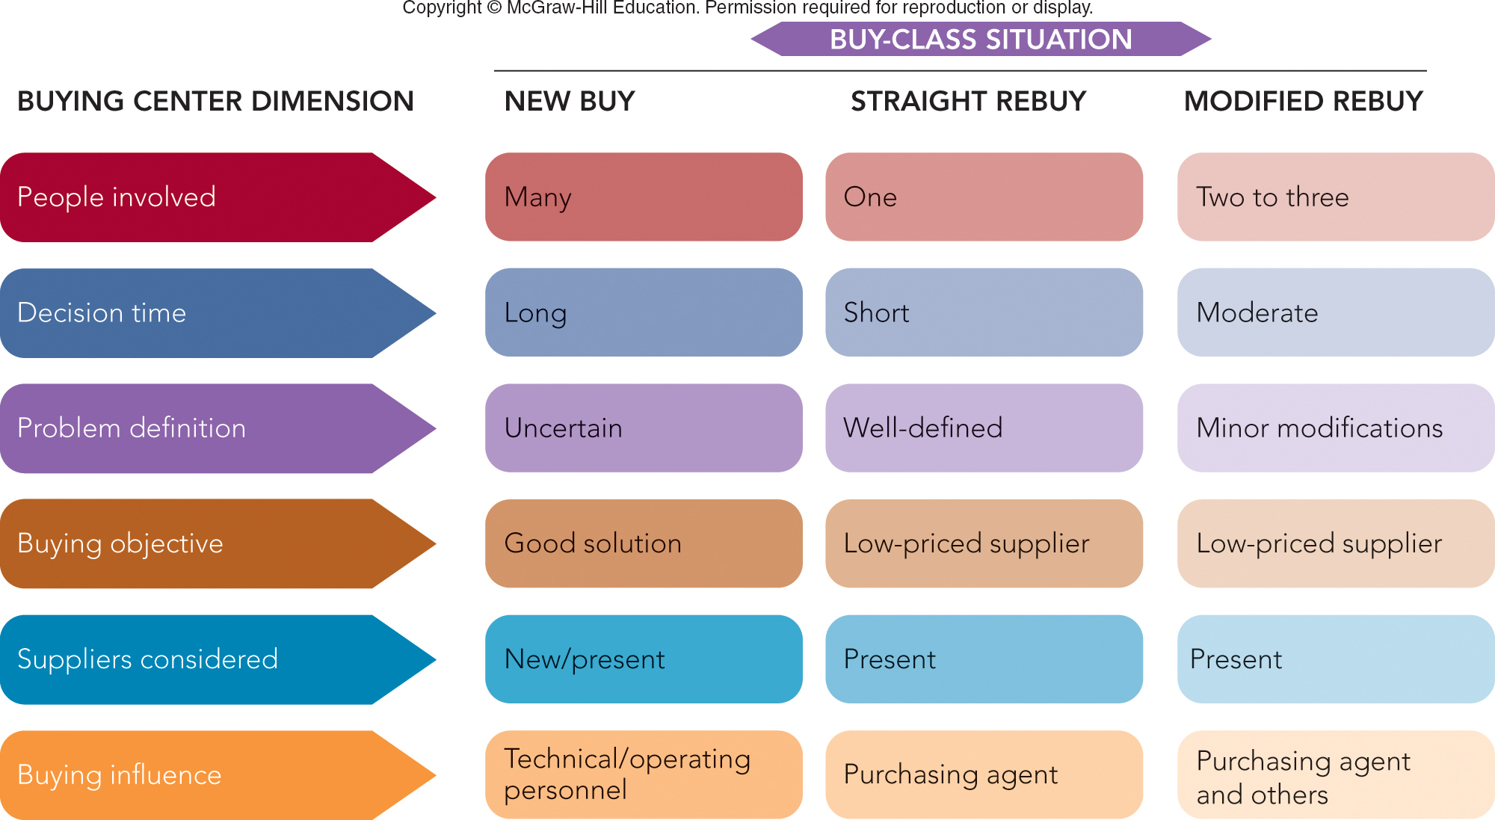
FIGURE 5-4 The buying situation affects buying center behavior in different ways.
Jump to Appendix 5 long image description

Slide 18
ONLINE BUYING IN BUSINESS-TO-BUSINESS MARKETING
Prominence of Online Buying in Organizational Markets
E-marketplaces
Online Auctions in Organizational Markets
Traditional Auction
Reverse Auction

Slide 19

MARKETING MATTERS eBay Means Business for Entrepreneurs
eBay Website
81% of Small Businesses Sell to 5+ Countries
82% Report It Helped Business Grow
78% Reduced Costs
79% Became More Profitable

Slide 20
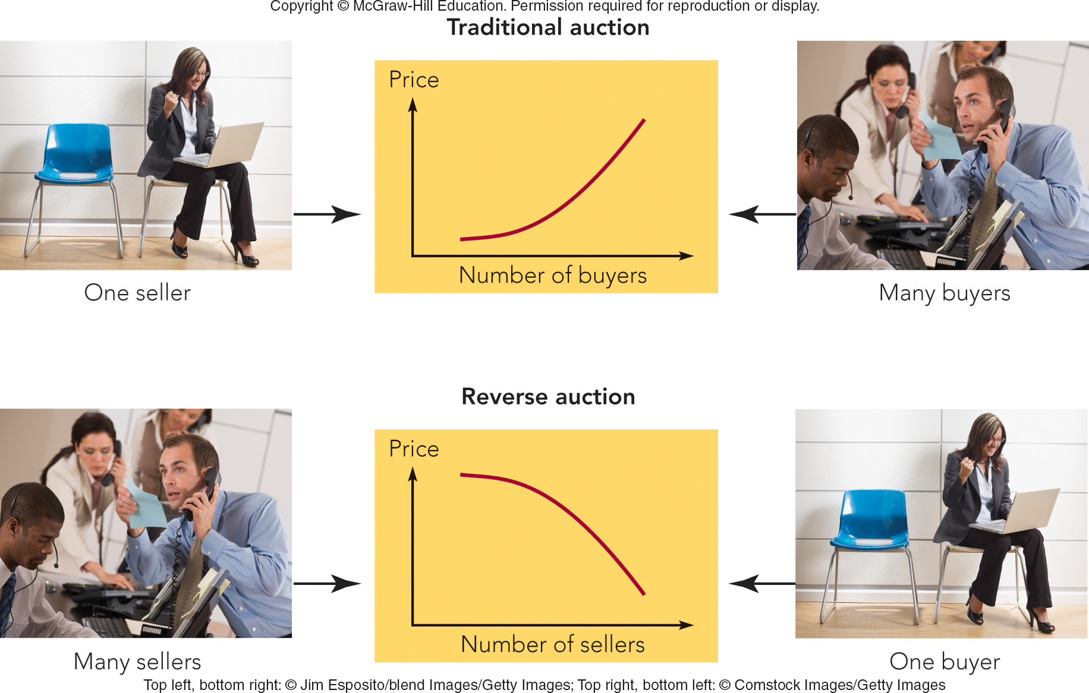
FIGURE 5-5 How buyer and seller participants and price behavior differ by type of online auction.
Jump to Appendix 6 long image description

Slide 21

VIDEO CASE 6 TREK: BUILDING BETTER BIKES THROUGH ORGANIZATIONAL BUYING
Trek Video
Case

Slide 22
VIDEO CASE 6 Trek (1 of 4)
What is the role of the buying center at Trek? Who is likely to comprise the buying center in the decision to select a new supplier at Trek?

Slide 23
VIDEO CASE 6 Trek (2 of 4)
What selection criteria does Trek utilize when it selects a new supplier or evaluates an existing supplier?

Slide 24
VIDEO CASE 6 Trek (3 of 4)
How has Trek’s interest in the environmental impact of its business influenced its organizational buying process?

Slide 25
VIDEO CASE 6 Trek (4 of 4)
Provide an example of each of the three buying situations—straight rebuy, modified rebuy, and new buy—at Trek.

Slide 26
IN-CLASS ACTIVITY 5-1
DAKTRONICS: REACHING AN ORGANIZATION’S BUYING CENTER

Slide 27
ICA 5-1 Daktronics: Buying Process
Example: Daktronics Products Reaching an Organization’s Buying Center
Dakronics Ad

Slide 28
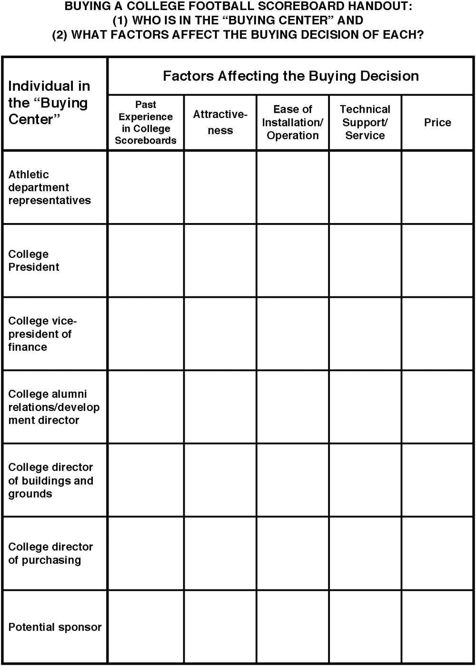
Daktronics handout

Slide 29
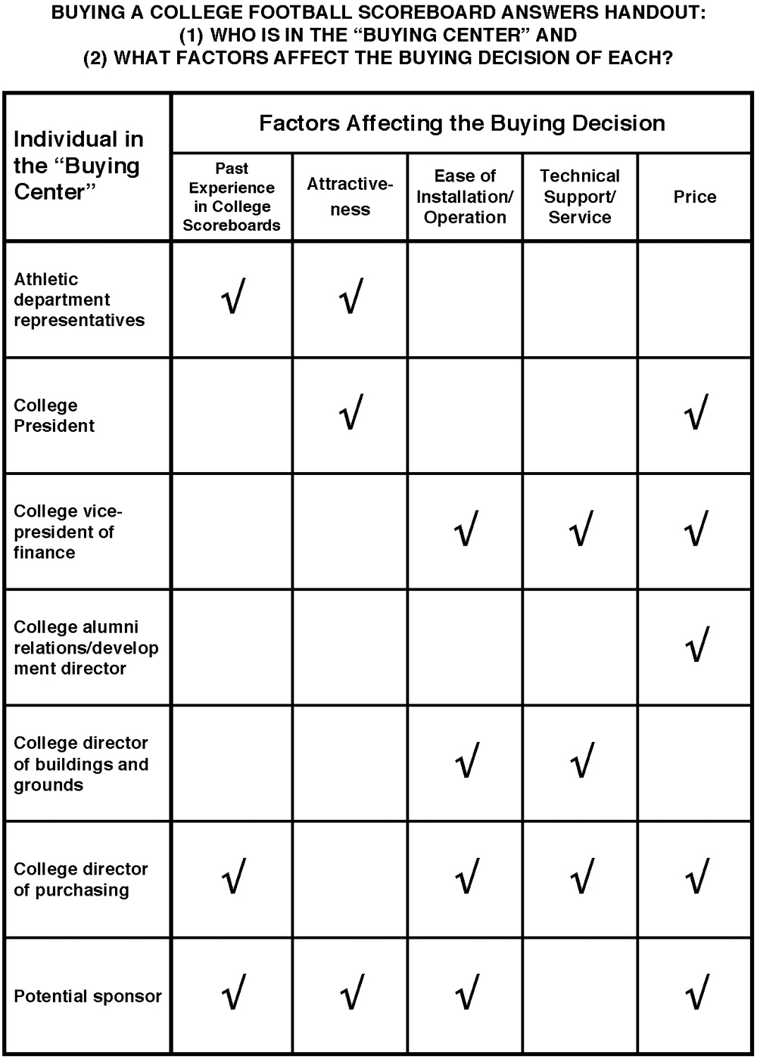
Daktronics answers handout

Slide 30


Business-to-Business Marketing
Business-to-business marketing involves the marketing of products and services to companies, governments, or not-for-profit organizations for use in the creation of goods and services that they can produce and market to others.

Slide 31
Organizational Buyers
Organizational buyers are those manufacturers, wholesalers, retailers, and government agencies that buy goods and services for their own use or for resale.

Slide 32
North American Industry Classification System (NAICS)
The North American Industry Classification System (NAICS) provides common industry definitions for Canada, Mexico, and the United States, which makes it easier to measure economic activity in the three member countries of the North American Free Trade Agreement (NAFTA).

Slide 33
Derived Demand
Derived demand is the demand for industrial products and services that is driven by, or derived from, the demand for consumer products and services.

Slide 34
Organizational Buying Criteria
Organizational buying criteria are the objective attributes of the supplier’s products and services and the capabilities of the supplier itself.

Slide 35
Supplier Development
Supplier development is the deliberate effort by organizational buyers to build relationships that shape suppliers’ products, services, and capabilities to fit a buyer’s needs and those of its customers.

Slide 36
Reciprocity
Reciprocity is an industrial buying practice in which two organizations agree to purchase each other’s products and services.

Slide 37
Supply Partnership
A supply partnership is a relationship that exists when a buyer and its supplier adopt mutually beneficial objectives, policies, and procedures for the purpose of lowering the cost or increasing the value of products and services delivered to the ultimate consumer.

Slide 38
Buying Center
A buying center consists of the group of people in an organization who participate in the buying process and share common goals, risks, and knowledge important to a purchase decision.

Slide 39
Buy Classes
Buy classes consist of three types of organizational buying situations: straight rebuy, new buy, and modified rebuy.

Slide 40
E-marketplaces
E-marketplaces are online trading communities that bring together buyers and supplier organizations to make possible the real time exchange of information, money, products, and services. Also called B2B exchanges or e-hubs.

Slide 41
Traditional Auction
A traditional auction, in an e-marketplace, is an online auction in which a seller puts an item up for sale and would-be buyers are invited to bid in competition with each other.

Slide 42
Reverse Auction
A reverse auction, in an e-marketplace, is an online auction in which a buyer communicates a need for a product or service and would-be suppliers are invited to bid in competition with each other.

Slide 43
Appendix 1 FIGURE 5-1 Key characteristics and dimensions of organizational buying behavior
Market characteristics: demand for industrial products and services is derived; few customers typically exist, and their purchase orders are large.
Product or service characteristics: products or services are technical in nature and purchased on the basis of specifications; many of the goods purchased are raw and semi finished; heavy emphasis is placed on delivery time, technical assistance, and post sale service.
Buying process characteristics: technically qualified and professional buyers follow established purchasing policies and procedures; buying objectives and criteria are typically spelled out, as are procedures for evaluating sellers and their products or services; there are multiple buying influences, and multiple parties participate in purchase decisions; there are reciprocal arrangements, and negotiation between buyers and sellers is commonplace; online buying over the Internet is widespread.
Marketing mix characteristics: direct selling to organizational buyers is the rule, and distribution is very important; advertising and other forms of promotion are technical in nature; price is often negotiated, evaluated as part of broader seller and product/service qualities, and frequently affected by quantity discounts.
Return to slide

Slide 44
Appendix 2 FIGURE 5-A Key Organizational Buying Criteria
Warranty/claim policies, technical capabilities, price, quality specifications, delivery schedules, past performance, and product facilities/capacity all lead to profit responsibility.
Return to slide

Slide 45
Appendix 3 FIGURE 5-2 Product and supplier selection criteria for buying machine vision equipment emphasize factors other than price.
The following criteria is important to machine vision buyers: performance (80 percent), technical support (68 percent), ease of use (67 percent), ease of setup (63 percent), complete solution including software (60 percent), ruggedness (56 percent), customization ability (53 percent), price (48 percent), integration expertise (42 percent), full tool set (42 percent), speed (38 percent).
Return to slide

Slide 46
Appendix 4 FIGURE 5-3 Comparing the stages in a consumer and organizational purchase decision process
The five stages of the buying decision process are listed, along with how each applies to a consumer purchase (a smartphone for a student) and a organizational purchase (an earbud headset for a smartphone).
1. Problem recognition. Consumer purchase: student doesn't like the features of the smartphone now owned and desires a new one. Organizational purchase: marketing research and sales departments observe that competitors are improving the earbud headsets for their smartphones. The firm decides to improve the earbud headsets on its own new models, which will be purchased from an outside supplier.
2. Information search. Consumer purchase: student uses personal past experience and that of friends, ads, the Internet, and Consumer Reports to collect information and uncover alternatives. Organizational purchase: design and production engineers draft specifications for earbud headsets. The purchasing department identifies suppliers of earbud headsets.
3. Alternative evaluation. Consumer purchase: Alternative smartphones are evaluated on the basis of important attributes desired in a phone, and several stores are visited. Organizational purchase: purchasing and engineering personnel visit with suppliers and assesses (1) facilities, (2) capacity, (3) quality control, and (4) financial status. They drop any suppliers not satisfactory on these attributes.
4. Purchase decision. Consumer purchase: a specific brand of smartphone is selected, the price is paid, and the student leaves the store. Organizational purchase: they use (1) quality, (2) price, (3) delivery, and (4) technical capability as key buying criteria to select a supplier. Then they negotiate terms and award a contract.
5. Post purchase behavior. Consumer purchase: student reevaluates the purchase decision and may return the phone to the store if it is unsatisfactory. Organizational purchase: they evaluate suppliers using a formal vendor rating system and notify a supplier if the earbud headsets do not meet their quality standard. If the problem is not corrected, they drop the firm as a future supplier.
Return to slide

Slide 47
Appendix 5 FIGURE 5-4 The buying situation affects buying center behavior in different ways
The six buying center dimensions are listed, as well as how they are affected by three buy-class situations: new buy, straight rebuy, and modified rebuy.
1. People involved. New buy: many. Straight rebuy: one. Modified rebuy: Two to three.
2. Decision time. New buy: long. Straight rebuy: short. Modified rebuy: moderate.
3. Problem definition. New buy: uncertain. Straight rebuy: well-defined. Modified rebuy: minor modifications.
4. Buying objective. New buy: good solution. Straight rebuy: low-priced supplier. Modified rebuy: low-priced supplier
5. Suppliers considered. New buy: new/present. Straight rebuy: present. Modified rebuy: present.
6. Buying influence. New buy: technical/operating personnel. Straight rebuy: purchasing agent. Modified rebuy: purchasing agent and others.
Return to slide

Slide 48
Appendix 6 FIGURE 5-5 How buyer and seller participants and price behavior differ by type of online auction
A line graph, labeled “price” on its vertical axis and “number of buyers” on its horizontal axis, shows an inclining curve in a traditional auction where there is one seller and many buyers.
A line graph, labeled “price” on its vertical axis and “number of sellers” on its horizontal axis, shows an declining arch in a reverse auction where there are many sellers and one buyer.
Return to slide

Slide 50

Understanding and Reaching Global Consumers and Markets

Slide 51
LEARNING OBJECTIVES (LO) AFTER READING CHAPTER 6, YOU SHOULD BE ABLE TO: (1 of 2)
1. Describe the nature and scope of world trade from a global perspective.
2. Identify the major trends that have influenced world trade and global marketing.
3. Identify the environmental forces that shape global marketing efforts.

Slide 52
LEARNING OBJECTIVES (LO) AFTER READING CHAPTER 6, YOU SHOULD BE ABLE TO: (2 of 2)
4. Name and describe the alternative approaches companies use to enter global markets.
5. Explain the distinction between standardization and customization when companies craft worldwide marketing programs.

Slide 53

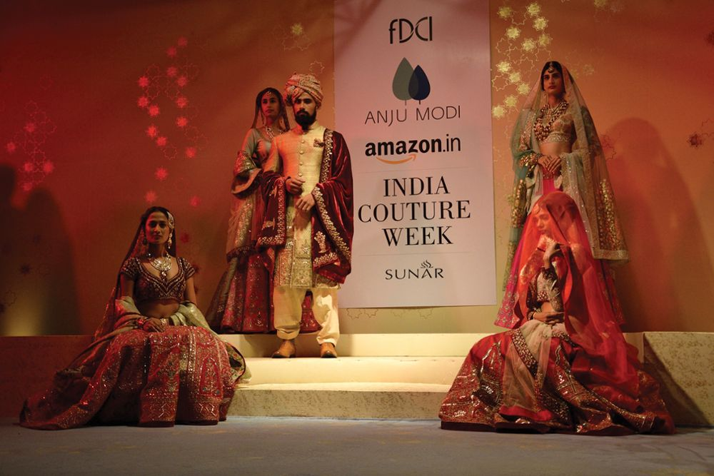
TRANSFORMING THE WAY INDIA BUYS: AMAZON BUILDS OPERATION FROM GROUND TO CLOUD
Amazon’s India
Website

Slide 54

DYNAMICS OF WORLD TRADE
Global Perspective
Value of World Trade Has Doubled
Products and Commodities: 80% of World Trade, Services: 20%
Trade Feedback Effect
Countertrade
United States Perspective
Gross Domestic Product (GDP)
Balance of Trade
Census Bureau

Slide 55
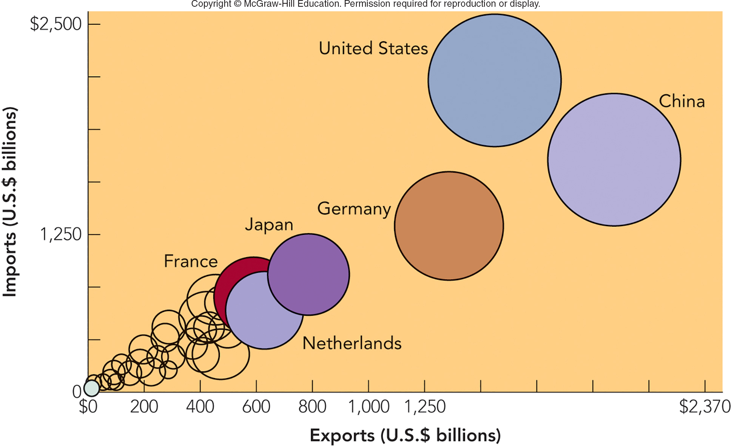
FIGURE 6-1 Leading countries in global merchandise trade in terms of imports (U.S.) and exports (China).
Jump to Appendix 1 long image description

Slide 56
MARKETING IN A BORDERLESS ECONOMIC WORLD TREND 1—DECLINE OF ECONOMIC PROTECTIONISM
Protectionism
Tariffs
Quota
World Trade Organization (WTO)
World Trade
Organization

Slide 57
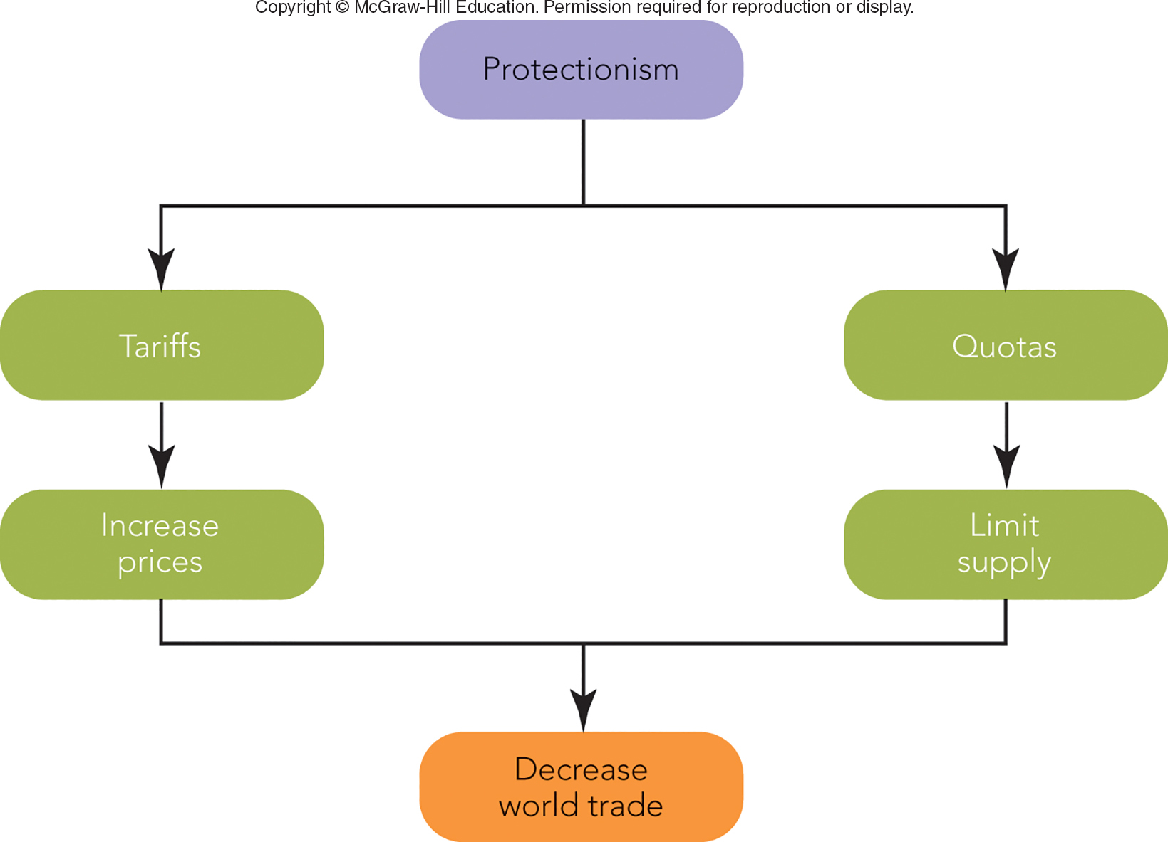
FIGURE 6-2 Protectionism hinders world trade when countries raise prices and limit supply through tariff and quota policies.
Jump to Appendix 2 long image description

Slide 58

MAKING RESPONSIBLE DECISIONS GLOBAL ETHICS AND GLOBAL ECONOMICS — THE CASE OF PROTECTIONISM
Protectionism Earns Profits for Domestic Producers and Government
Japan: Consumers Pay $75-$100B/Year in Higher Prices
U.S.: $70B/Year

Slide 59
MARKETING IN A BORDERLESS ECONOMIC WORLD TREND 2—RISE OF ECONOMIC INTEGRATION
European Union (EU) – 28 Countries Eliminated Barriers to Trade
Euro (Common Currency)
North American Free Trade Agreement (NAFTA) – Lifted Trade Barriers Between Canada, Mexico, and U.S. (475 Million Consumers)
46% of U.S. Exports Are to Free Trade Partners
Euro Video

Slide 60
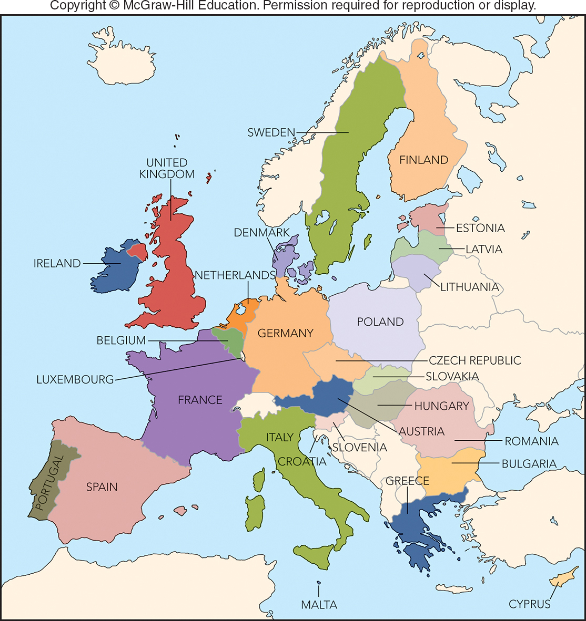
FIGURE 6-3 The European Union in 2017 consists of 28 countries with more than 500 million consumers.
European
Union countries

Slide 61

MARKETING IN A BORDERLESS ECONOMIC WORLD TREND 3—GLOBAL COMPETITION FOR GLOBAL CUSTOMERS
Global Competition
Strategic Alliances

Slide 62
FIGURE 6-A Global Companies and Marketing Strategy
TYPE OF GLOBAL COMPANY | TYPES OF MARKETING STRATEGY
International Firm | Extension of Home Marketing Strategy
Multinational Firm | Multi-domestic Marketing Strategy
Transnational Firm | Global Marketing Strategy

Slide 63
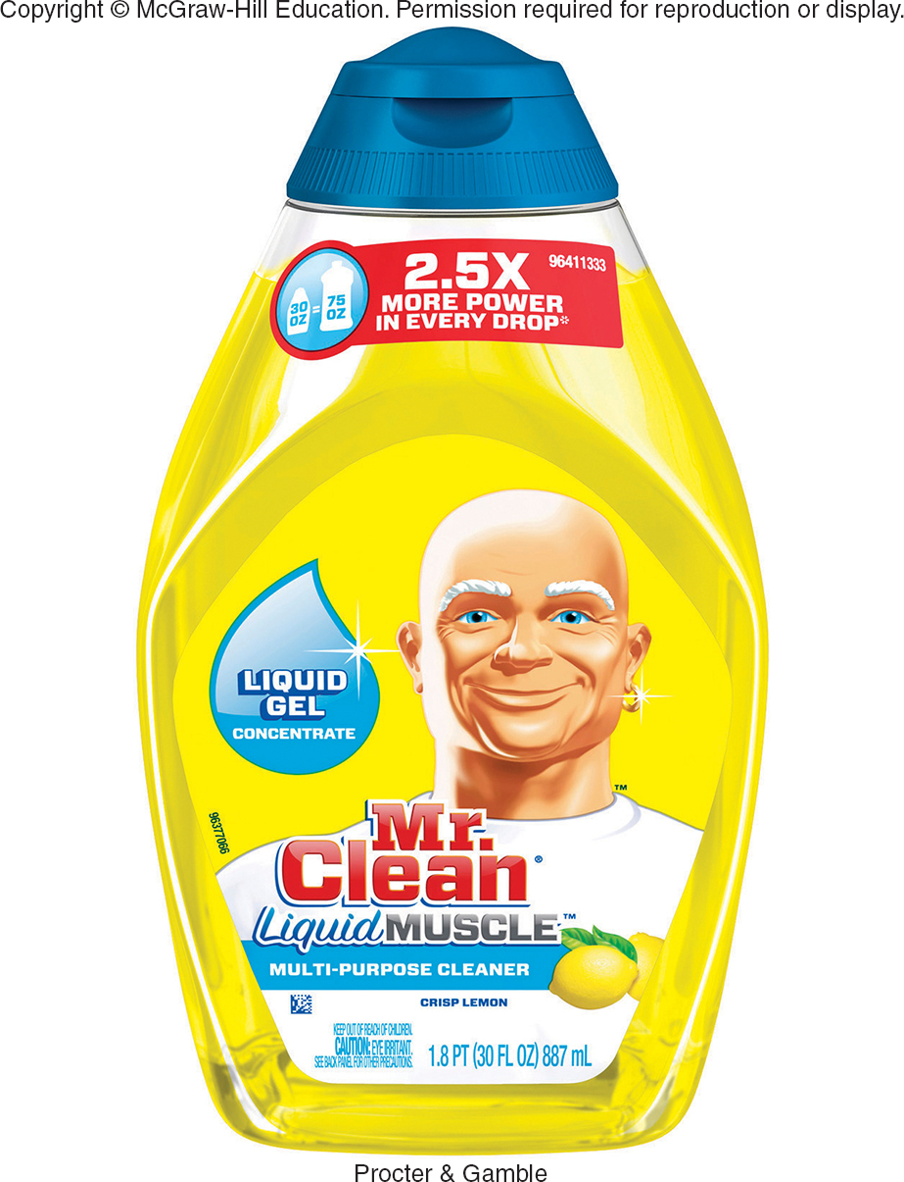
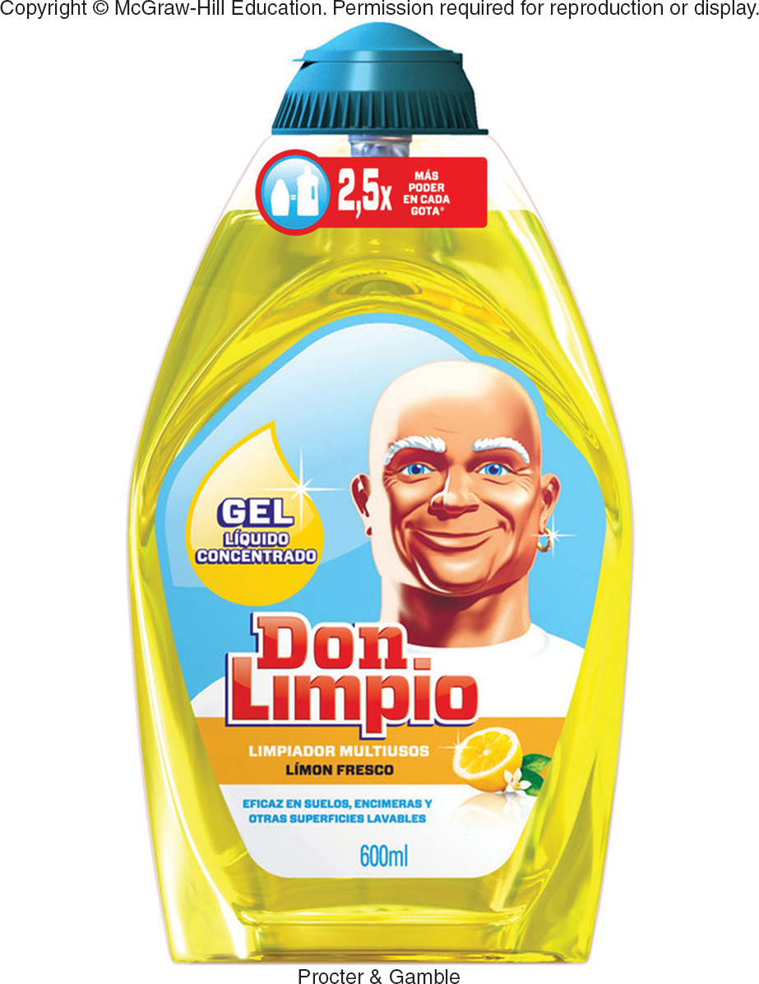
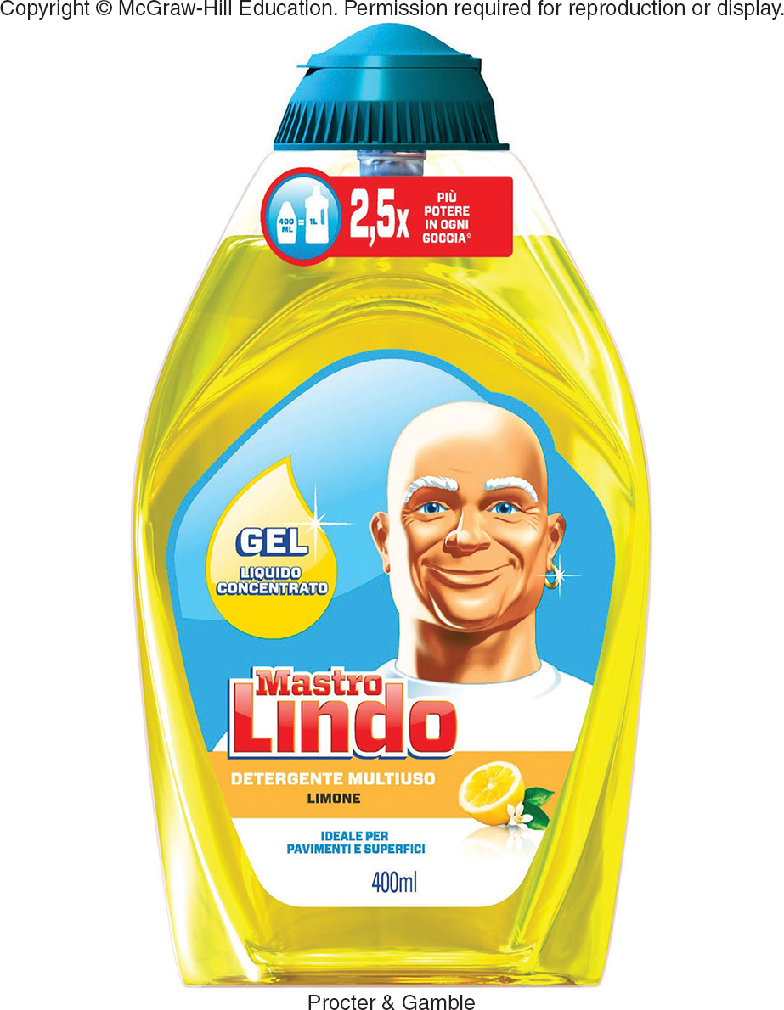
MARKETING IN A BORDERLESS ECONOMIC WORLD TREND 3—GLOBAL COMPANIES FOR GLOBAL CUSTOMERS
International Firms
Multinational Firms
Multidomestic Marketing Strategy
Transnational Firms
Global Marketing Strategy
Global Brand

Slide 64
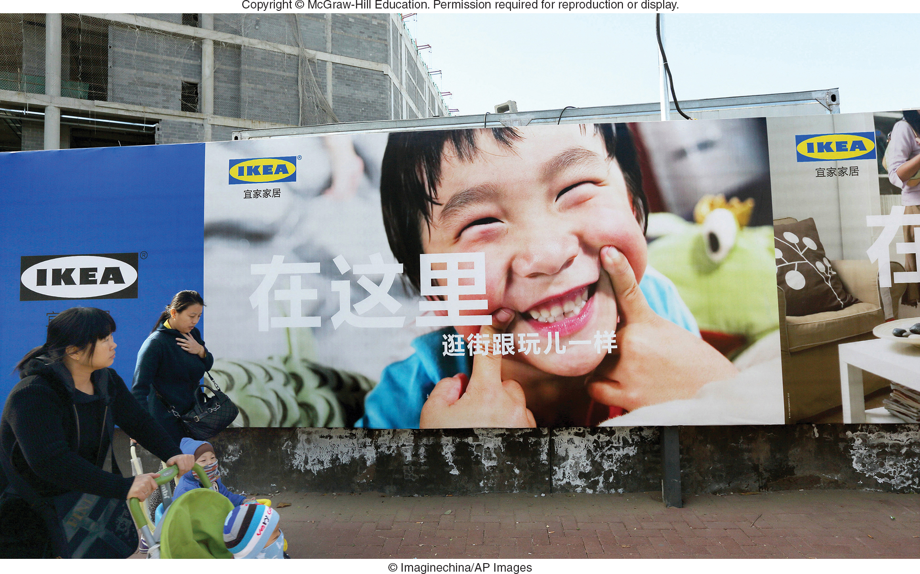
MARKETING IN A BORDERLESS ECONOMIC WORLD TREND 3—GLOBAL CUSTOMERS
Global Consumers – Consumer Groups in Different Countries with Similar Needs

Slide 65

MARKETING MATTERS The Global Teenager—A Market of 2 Billion Voracious Consumers
Global Teen Market of 2 Billion
Teens’ Rooms Look Similar No Matter the Country
Teens Spend $820B Annually for Common Products (Jeans, Video Games, etc.)

Slide 66
MARKETING IN A BORDERLESS ECONOMIC WORLD TREND 4 — NETWORKED GLOBAL MARKETPLACE
Marketspace Enables Exchange Anywhere, Anytime, and at Lower Cost
Access to Buyers on Every Continent
Nestle Hungary
Ad

Slide 67
MARKETING IN A BORDERLESS ECONOMIC WORLD TREND 5 — GROWING ECONOMIC ESPIONAGE
Economic Espionage Exists!
Clandestine Collection of Trade Secrets or Proprietary Information about Competitors
Costs U.S. Firms $250+ Billion/Year
23 Nations Routinely Target U.S. Firms
Economic Espionage Act (1996) Makes Theft a Federal Crime

Slide 68

A GLOBAL ENVIRONMENTAL SCAN CULTURAL DIVERSITY (1 of 3)
Cross-Cultural Analysis
Values
Customs
Foreign Corrupt Practices Act (1977)

Slide 69
FIGURE 6-B Cultural Appreciation
Aspects of Culture
Values
Customs
Symbols
Language

Slide 70

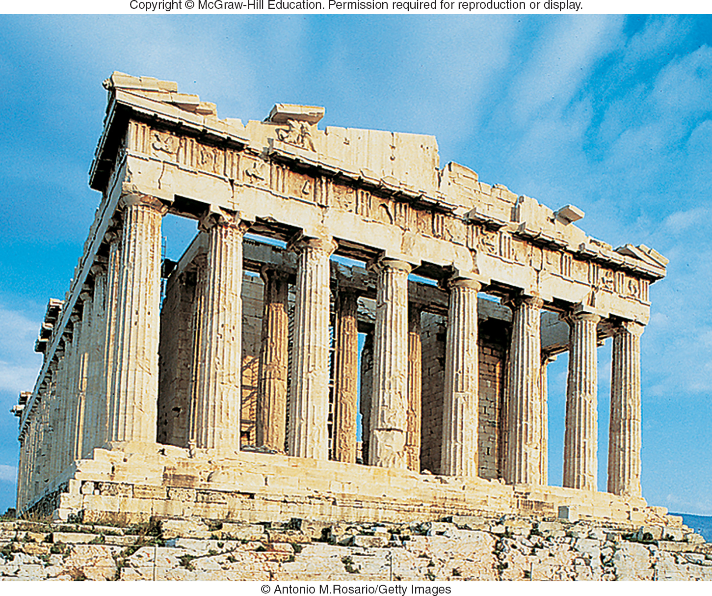
A GLOBAL ENVIRONMENTAL SCAN CULTURAL DIVERSITY (2 of 3)
Cultural Symbols – Evoke Deep Feelings

Slide 71



A GLOBAL ENVIRONMENTAL SCAN CULTURAL DIVERSITY (3 of 3)
Language
Unintended Meanings
Back Translation
Japanese Translation:
“Surely Win”
Nestle Japan
Ad
Italian translation:
“Stop Looking at My Rear”
Jump to Appendix 3 long image description

Slide 72

A GLOBAL ENVIRONMENTAL SCAN ECONOMIC CONSIDERATIONS (1 of 2)
Economic and Communication Infrastructure Crucial to Marketing
Example: PepsiCo Invested $1.5 Billion in Transportation and Manufacturing Systems in China and India

Slide 73
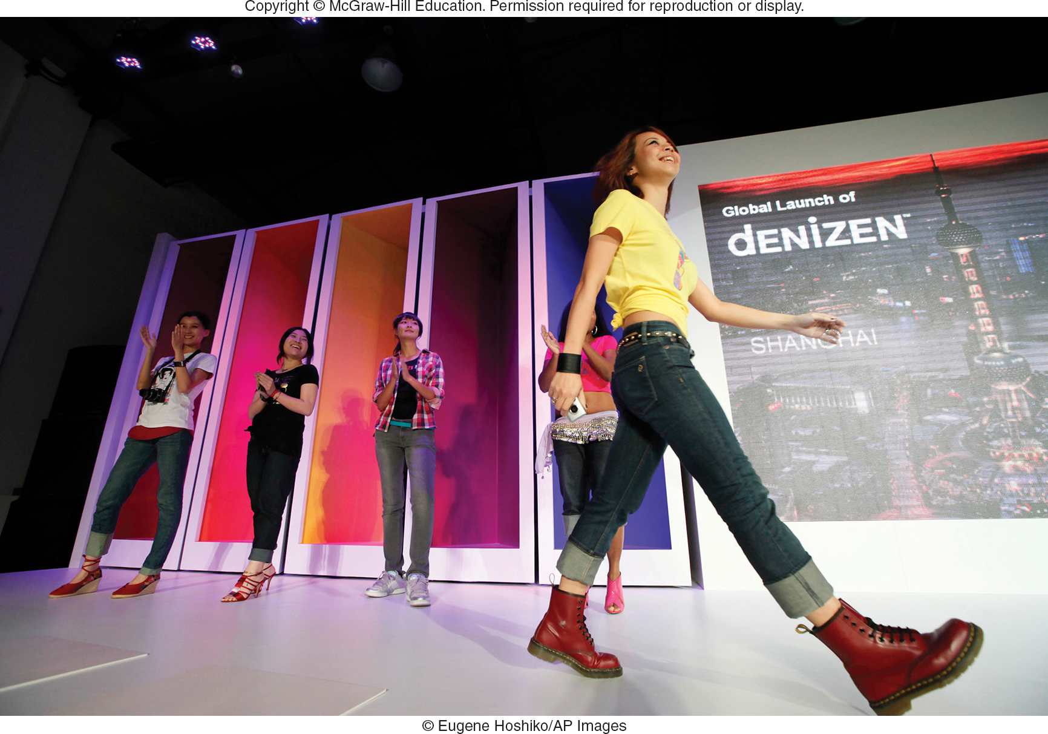
A GLOBAL ENVIRONMENTAL SCAN ECONOMIC CONSIDERATIONS (2 of 2)
Financial and Legal Systems Understanding
Consumer Income and Purchasing Power
Currency Exchange Rate
Denizen Ad

Slide 74

POLITICAL STABILITY
Billions of Dollars of Trade Lost Due to Terrorism and War
Political Stability Is Monitored and Tracked
PRS Group
Website

Slide 75
A GLOBAL ENVIRONMENTAL SCAN POLITICAL-REGULATORY CLIMATE
Impacts of Political Stability
Impact on Economy from Trade Regulations

Slide 76
COMPARING MARKET-ENTRY STRATEGIES ALTERNATIVE APPROACHES
Exporting
Indirect Exporting
Direct Exporting
Licensing
Joint Venture
Direct Investment

Slide 77
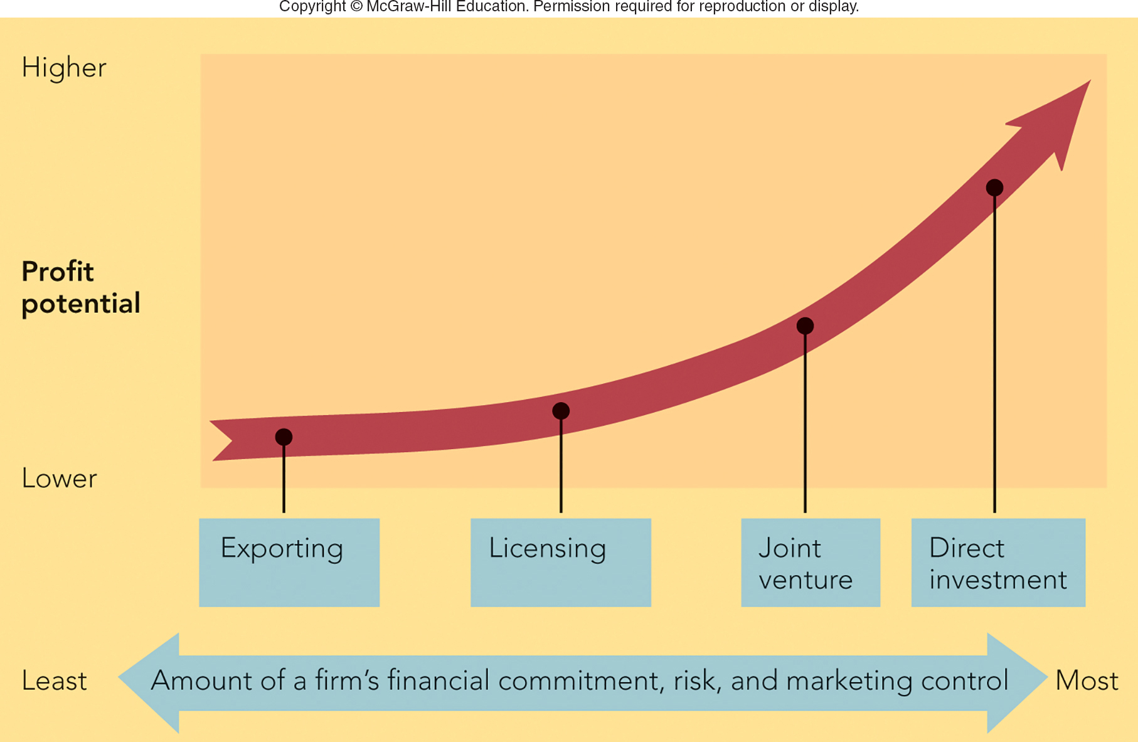
FIGURE 6-4 Alternative global market-entry strategies
Jump to Appendix 4 long image description

Slide 78

MARKETING MATTERS Creative Cosmetics and Creative Export Marketing in Japan
How to Sell in Japan?
Top Quality Product
Effective Advertising
Sell Through Network of Japanese Distributors to Reach Beauty Salons
Fran Wilson
Website

Slide 79
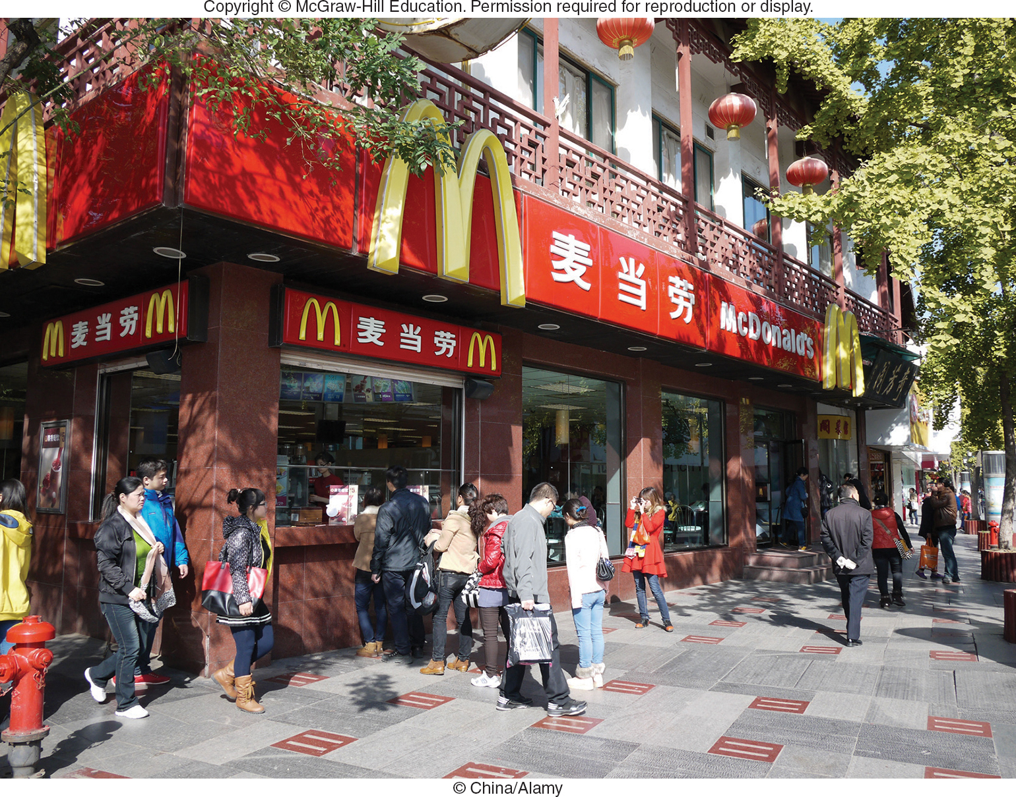
GLOBAL MARKET-ENTRY STRATEGIES LICENSING
Licensing
Advantages
Disadvantages
Contract
Manufacturing
Contract Assembly
Franchising

Slide 80
GLOBAL MARKET-ENTRY STRATEGIES JOINT VENTURE
Joint Venture
Sharing Ownership, Control, and Profits
Advantages and Disadvantages?
Direct Investment
Biggest Commitment to Enter Global Market
Advantages and Disadvantages?

Slide 81
CRAFTING A WORLDWIDE MARKETING PROGRAM PRODUCT AND PROMOTION STRATEGIES (1 of 2)
Product Extension – Same Product, Different Countries
Product Adaptation – Change Product for Different Countries
Product Invention – New Product for Different Countries

Slide 82
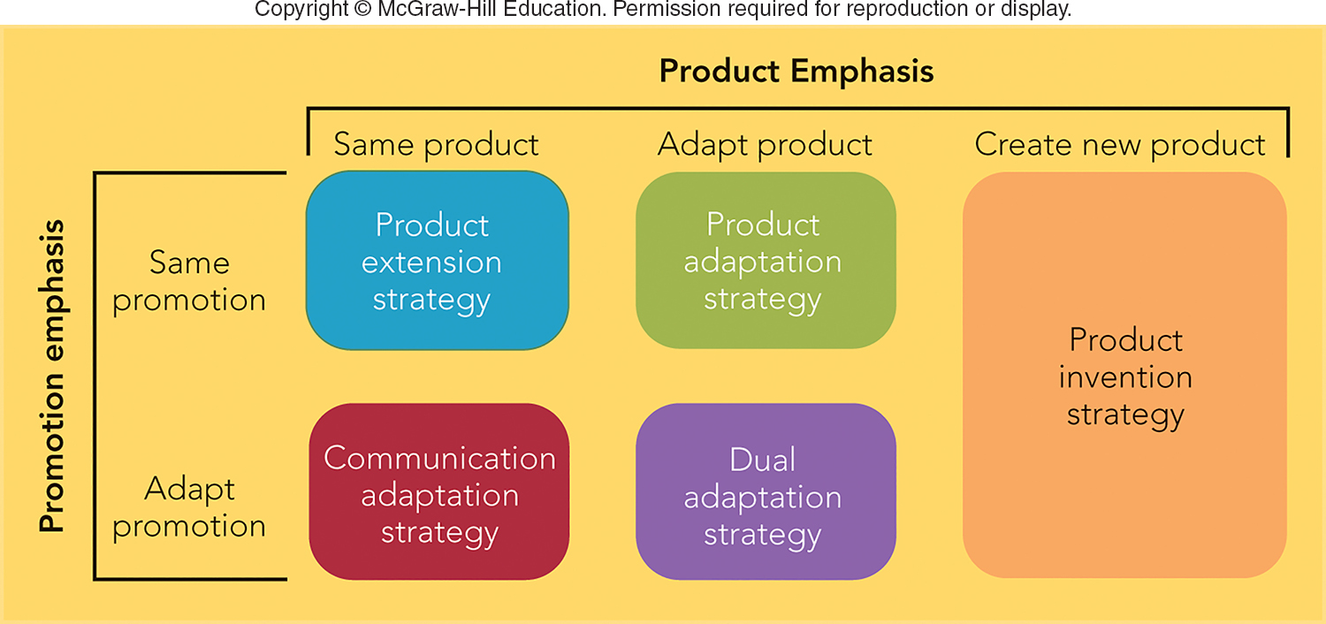
FIGURE 6-5 Five product and promotion strategies for global marketing
Jump to Appendix 5 long image description

Slide 83



CRAFTING A WORLDWIDE MARKETING PROGRAM PRODUCT AND PROMOTION STRATEGIES (2 of 2)
Identical Message
Communication Adaptation
Dual Adaptation
Nescafe China

Slide 84
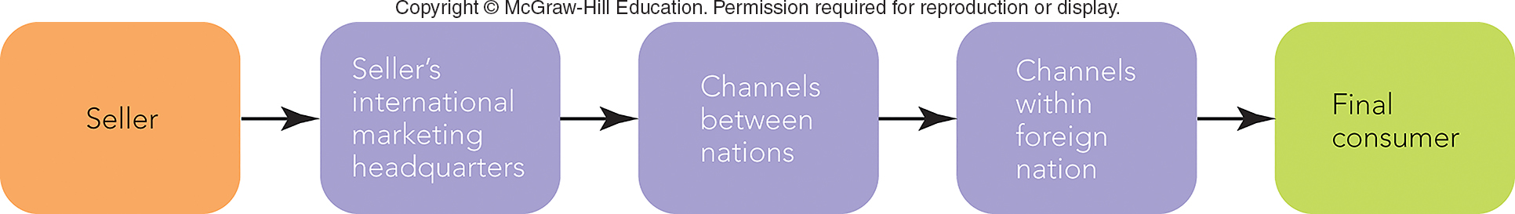
FIGURE 6-6 Channels of distribution in global marketing
Jump to Appendix 6 long image description

Slide 85
CRAFTING A WORLDWIDE MARKETING PROGRAM DISTRIBUTION AND PRICING STRATEGIES
Channels and Economic Development
Channels Can Be Long or Short
Countries Impose Pricing Constraints
Prices May Be Too High or Too Low
Dumping
Gray Market (Also Called Parallel Importing)

Slide 86

VIDEO CASE 7 MARY KAY, INC.: BUILDING A BRAND IN INDIA
Mary Kay
Video Case

Slide 87
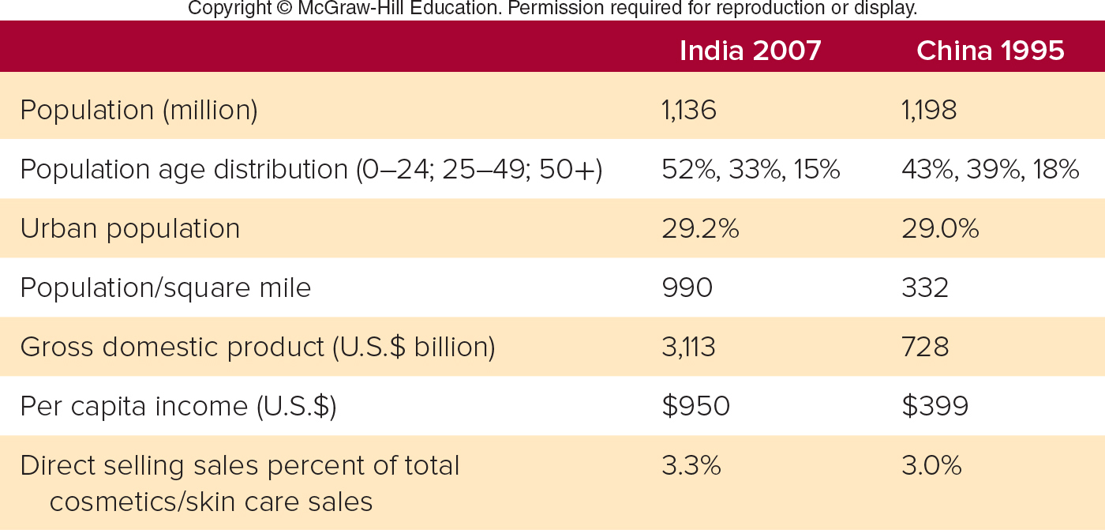
FIGURE 1 Social and economic statistics for India in 2007 and China in 1995
Jump to Appendix 7 long image description

Slide 88
VIDEO CASE 7 Mary Kay (1 of 3)
Is Mary Kay an international firm, a multinational firm, or a transnational firm based on its marketing strategy? Why?

Slide 89
VIDEO CASE 7 Mary Kay (2 of 3)
What global market-entry strategy did Mary Kay use when it entered India?

Slide 90
VIDEO CASE 7 Mary Kay (3 of 3)
Is Mary Kay a global brand? Why or why not?

Slide 91
IN-CLASS ACTIVITY 6-1
INTRODUCING CARMEX HEALING CREAM TO EUROPEAN MARKETS

Slide 92
ICA 6-1 Carmex Healing Cream (U.S. to European Markets)
Example: Introducing Carmex Healing Cream to European Markets.
Carmex Video

Slide 93
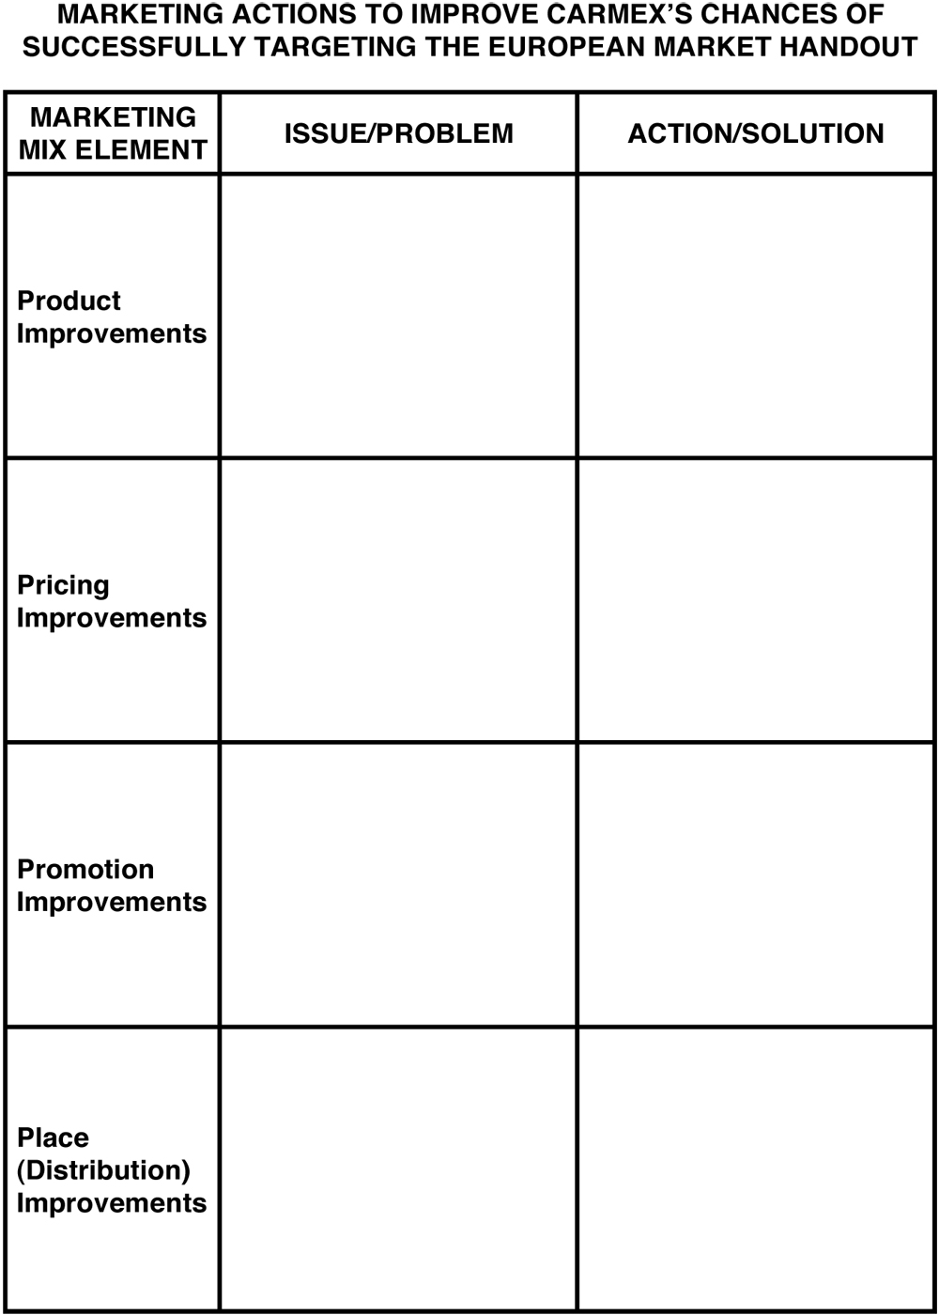
Carmex Handout.

Slide 94
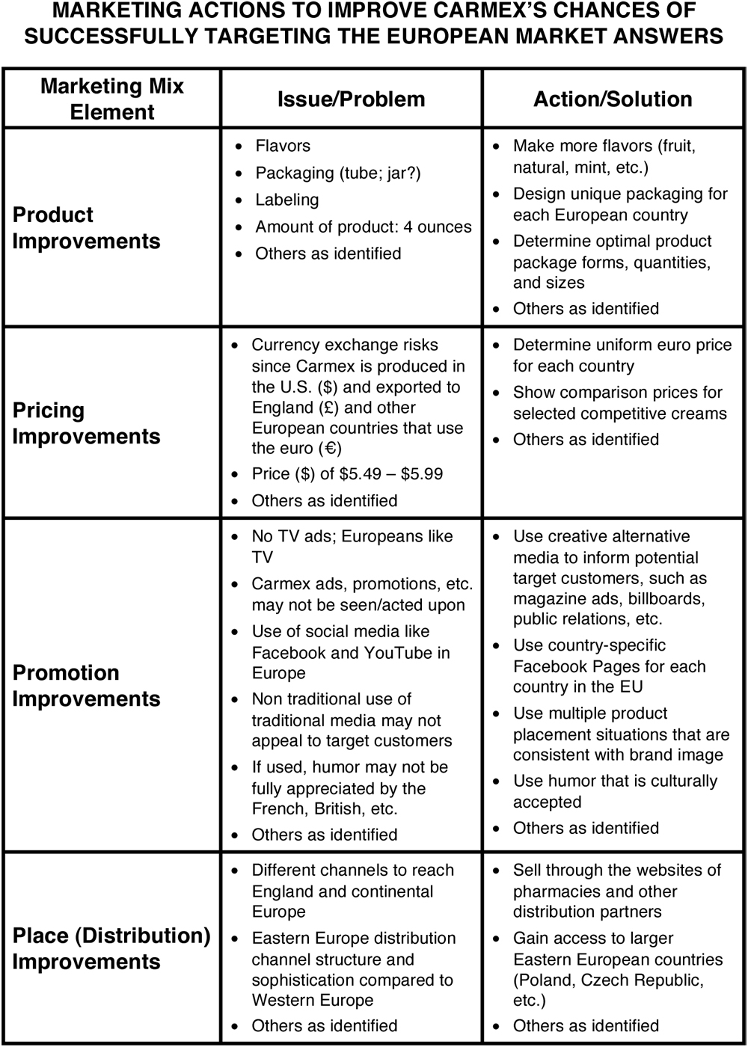
Carmex Handout Answers.

Slide 95
Countertrade
Countertrade is the practice of using barter rather than money for making global sales.

Slide 96
Gross Domestic Product (GDP)
Gross domestic product (GDP) is the monetary value of all products and services produced in a country during one year.

Slide 97
Balance of Trade
Balance of trade is the difference between the monetary value of a nation’s exports and imports.

Slide 98
Economic Espionage Act (1996)
The Economic Espionage Act (1996) is a law that makes the theft of trade secrets by foreign entities a federal crime in the United States.

Slide 99
Protectionism
Protectionism is the practice of shielding one or more industries within a country’s economy from foreign competition through the use of tariffs or quotas.

Slide 100
Tariffs
Tariffs are government taxes on products or services entering a country that primarily serve to raise prices on imports.

Slide 101
Quota
A quota is a restriction placed on the amount of a product allowed to enter or leave a country.

Slide 102
World Trade Organization (WTO)
The World Trade Organization (WTO) is a permanent institution that sets rules governing trade between its members through panels of trade experts who decide on trade disputes between members and issue binding decisions.

Slide 103
Global Competition
Global competition exists when firms originate, produce, and market their products and services worldwide.

Slide 104
Strategic Alliances
Strategic alliances are agreements among two or more independent firms to cooperate for the purpose of achieving common goals such as a competitive advantage or customer value creation.

Slide 105
Multidomestic Marketing Strategy
A multidomestic marketing strategy involves multinational firms that have as many different product variations, brand names, and advertising programs as countries in which they do business.

Slide 106
Global Marketing Strategy
A global marketing strategy involves transnational firms that employ the practice of standardizing marketing activities when there are cultural similarities and adapting them when cultures differ.

Slide 107
Global Brand
A global brand is a brand marketed under the same name in multiple countries with similar and centrally coordinated marketing programs.

Slide 108
Global Consumers
Global consumers are consumer groups living in many countries or regions of the world who have similar needs or seek similar features and benefits from products or services.

Slide 109
Cross-Cultural Analysis
Cross-cultural analysis involves the study of similarities and differences among consumers in two or more nations or societies.

Slide 110
Values
Values are a society’s personally or socially preferable modes of conduct or states of existence that tend to persist over time.

Slide 111
Customs
Customs are what is considered normal and expected about the way people do things in a specific country.

Slide 112
Foreign Corrupt Practices Act (1977)
The Foreign Corrupt Practices Act (1977) is a law, amended by the International Anti-Dumping and Fair Competition Act (1998), that makes it a crime for U.S. corporations to bribe an official of a foreign government or political party to obtain or retain business in a foreign country.

Slide 113
Cultural Symbols
Cultural symbols are things that represent ideas and concepts.

Slide 114
Back Translation
Back translation is the practice where a translated word or phrase is retranslated into the original language by a different interpreter to catch errors.

Slide 115
Currency Exchange Rate
A currency exchange rate is the price of one country’s currency expressed in terms of another country’s currency.

Slide 116
Exporting
Exporting is a global market-entry strategy in which a company produces products in one country and sells them in another country.

Slide 117
Joint Venture
Joint venture is a global market-entry strategy in which a foreign company and a local firm invest together to create a local business in order to share the ownership, control, and profits of the new company.

Slide 118
Direct Investment
Direct investment is a global market-entry strategy that entails a domestic firm actually investing in and owning a foreign subsidiary or division.

Slide 119
Dumping
Dumping occurs when a firm sells a product in a foreign country below its domestic price or below its actual cost.

Slide 120
Gray Market
A gray market is a situation where products are sold through unauthorized channels of distribution. Also called parallel importing.

Slide 121
Appendix 1 FIGURE 6-1 Leading countries in global merchandise trade in terms of imports (U.S.) and exports (China).
From lowest to highest, the graph plots France, the Netherlands, Japan, Germany, the U.S., and China based on their imports and exports. The graph shows France imports slightly more than the Netherlands, and the U.S. imports more than China, with Germany in the middle.
Return to slide

Slide 122
Appendix 2 FIGURE 6-2 Protectionism hinders world trade when countries raise prices and limit supply through tariff and quota policies.
Protectionism breaks into two branches. Tariffs lead to an increase in prices, while quotas limit supply. Both branches lead to a decrease in world trade.
Return to slide

Slide 123
Appendix 3 A GLOBAL ENVIRONMENTAL SCAN CULTURAL DIVERSITY
Two advertisements, one English, one Italian, show the same rear shot of a Mini Cooper. The English ad's copy reads “stop staring at my boot,” while the Italian ad translates to “stop looking at my rear.”
Return to slide

Slide 124
Appendix 4 FIGURE 6-4 Alternative global market-entry strategies
Four stages are shown.
The first stage, exporting, has low profit potential and the least amount of control.
The second stage, licensing, increases in profit potential and control.
The third stage, joint venture, sees a marked increase in profit potential and control.
The fourth stage, direct investment, sees the highest amounts of profit potential and control.
Return to slide

Slide 125
Appendix 5 FIGURE 6-5 Five product and promotion strategies for global marketing
Five product and promotion strategies are based on combinations of product emphasis and promotion emphasis.
Product extension strategy (same product, same promotion).
Communication adaption strategy (same product, adapt promotion).
Product adaption strategy (adapt product, same promotion).
Dual adaption strategy (adapt product, adapt promotion).
Product invention strategy (create new product, same promotion or adapt promotion).
Return to slide

Slide 126
Appendix 6 FIGURE 6-6 Channels of distribution in global marketing
The channels of distribution start with the seller, then go to the seller's international marketing headquarters, followed by the channels between nations, the channels within a foreign nation, and end with the final consumer.
Return to slide

Slide 127
Appendix 7 FIGURE 1 Social and economic statistics for India in 2007 and China in 1995
India 2007. Population 1,136 million. Population age distribution 0 to 24, 52 percent; 25 to 49, 33 percent; 50 and older, 15 percent. Urban population 29.2 percent. Population per square mile 990. Gross domestic product 3,113 billion U.S. dollars. Per capita income 950 U.S. dollars. Direct selling sales percent of total cosmetics and skin care sales 3.3 percent.
China 1995. Population 1,198 million. Population age distribution 0 to 24, 43 percent; 25 to 49, 39 percent; 50 and older, 18 percent. Urban population 29.0 percent. Population per square mile 332. Gross domestic product 728 billion U.S. dollars. Per capita income 399 U.S. dollars. Direct selling sales percent of total cosmetics and skin care sales 3.0 percent.
Return to slide

Slide 129

Marketing Research: From Customer Insights to Actions

Slide 130
LEARNING OBJECTIVES (LO) AFTER READING CHAPTER 7, YOU SHOULD BE ABLE TO: (1 of 2)
1. Identify the reason for conducting marketing research.
2. Describe the five-step marketing research approach that leads to marketing actions.
3. Explain how marketing uses secondary and primary data.

Slide 131
LEARNING OBJECTIVES (LO) AFTER READING CHAPTER 7, YOU SHOULD BE ABLE TO: (2 of 2)
4. Discuss the uses of observations, questionnaires, panels, experiments, and newer data collection methods.
5. Explain how data analytics and data mining lead to marketing actions.
6. Describe three approaches to developing a company’s sales forecast.

Slide 132

MARKETING RESEARCH GOES TO THE MOVIES
A Film Industry Secret: Research
Movie Title Testing
Concept Testing & Script Assessment
Test Screening
Tracking Studies
Pirates of the Caribbean
Movie Trailer

Slide 133
THE ROLE OF MARKETING RESEARCH
What is Marketing Research?
The Challenges in Doing Good Marketing Research
Five-Step Marketing Research Approach
Decision
Decision Making

Slide 134
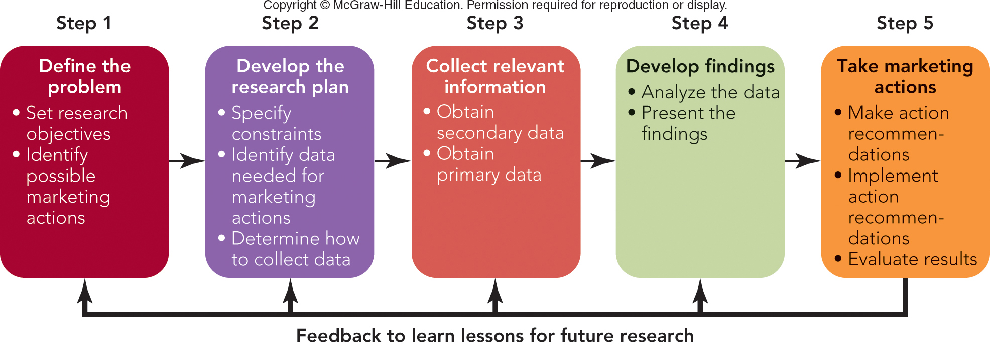
FIGURE 7-1 Five-step marketing research approach leading to marketing actions.
Jump to Appendix 1 long image description

Slide 135
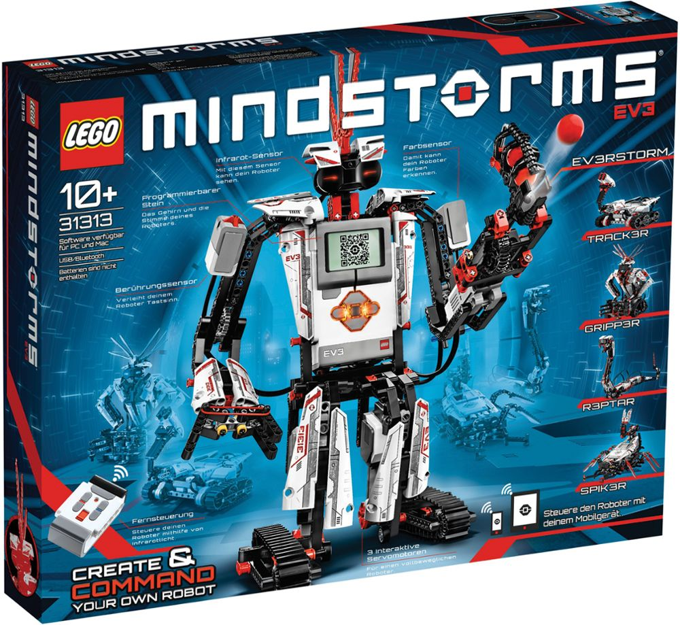
STEP 1: DEFINE THE PROBLEM SET THE RESEARCH OBJECTIVES (1 of 2)
Set the Research Objectives
Have a Clear Research Purpose
Identify Possible Marketing Actions
Lego EV3
Mindstorms
Video

Slide 136
STEP 1: DEFINE THE PROBLEM SET THE RESEARCH OBJECTIVES (2 of 2)
Measures of Success
Measure of Success: Playtime
Children Spend More Time Playing with New Design
Possible Marketing Actions
Introduce New Design
Drop Old Design

Slide 137
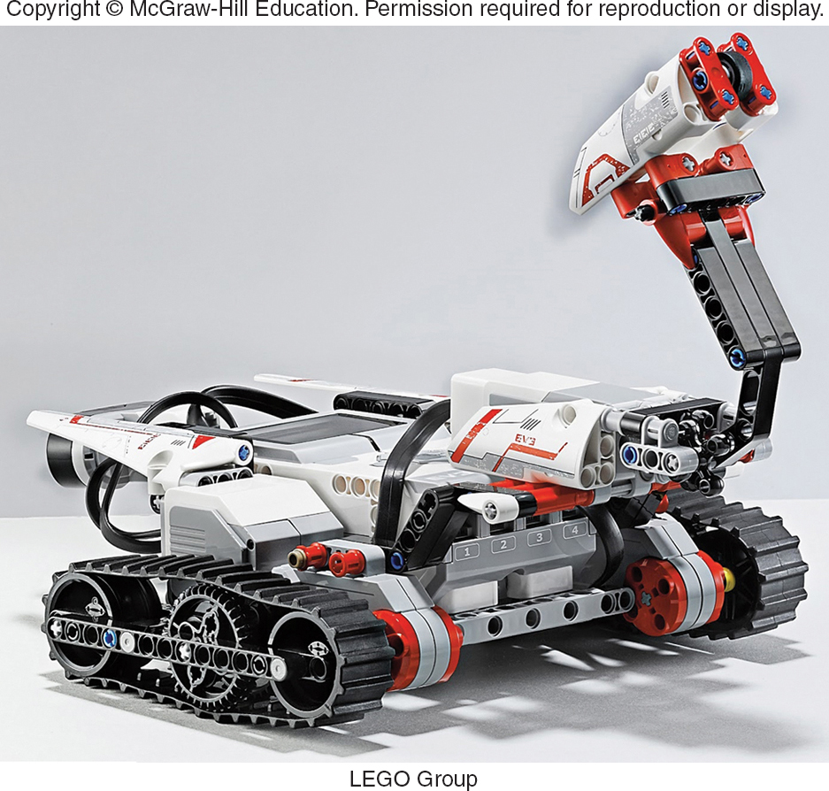
STEP 2: DEVELOP THE RESEARCH PLAN DETERMINE HOW TO COLLECT DATA
Constraints
Identify Data Needed for Marketing Actions
Identify Data Needed
Determine How to Collect Data
Concepts
Methods

Slide 138
STEP 3: COLLECT RELEVANT INFORMATION/DATA
Relevant Information for Rational, Informed Marketing Decision
Data
Secondary Data
Primary Data

Slide 139
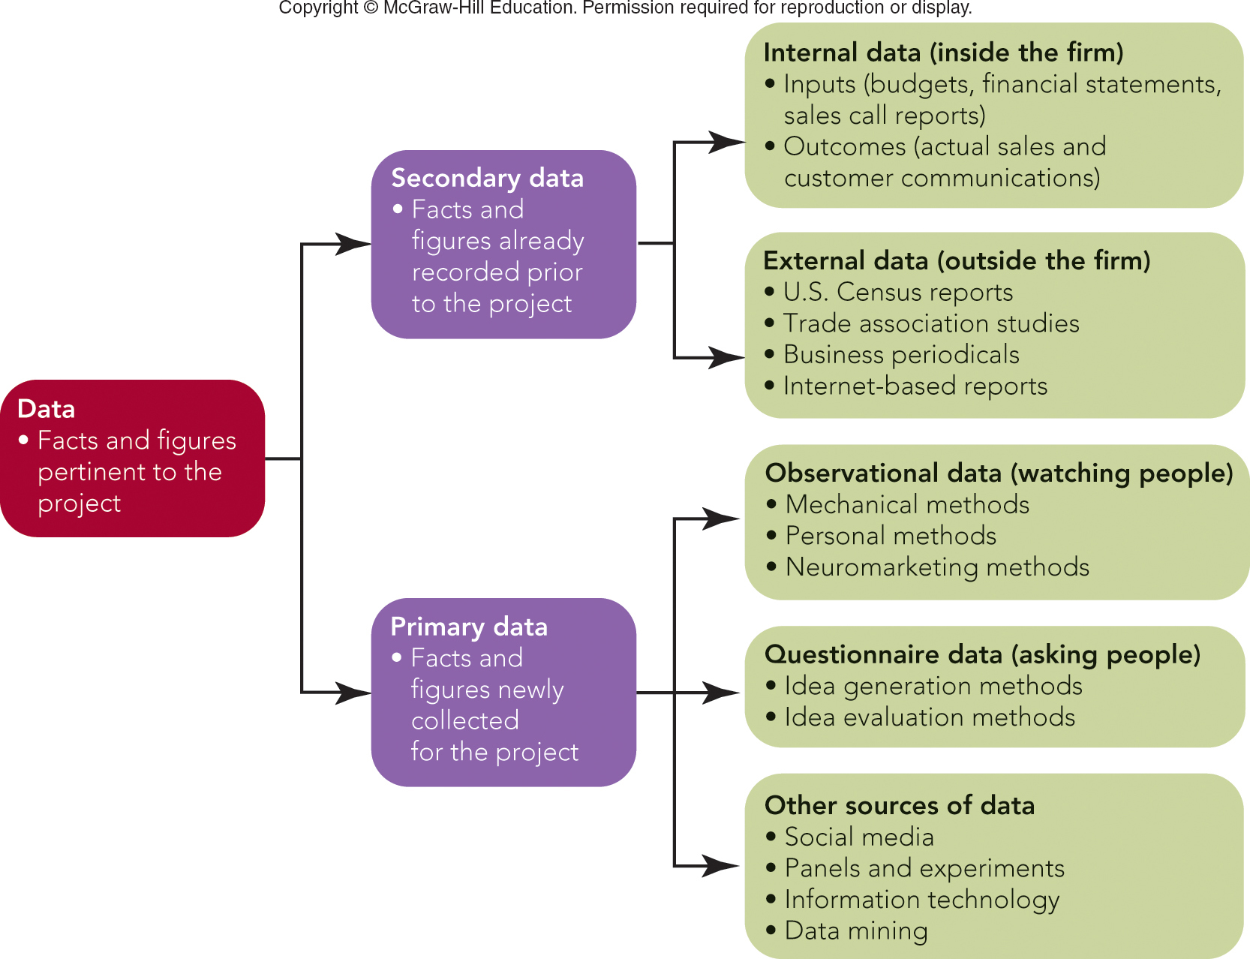
FIGURE 7-2 Types of marketing information
Jump to Appendix 2 long image description

Slide 140
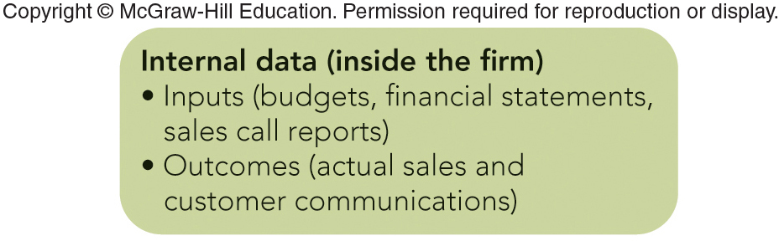
STEP 3: COLLECT RELEVANT DATA SECONDARY DATA (1 of 5)
Internal
Marketing Input Data
Marketing Outcome Data
Jump to Appendix 3 long image description

Slide 141
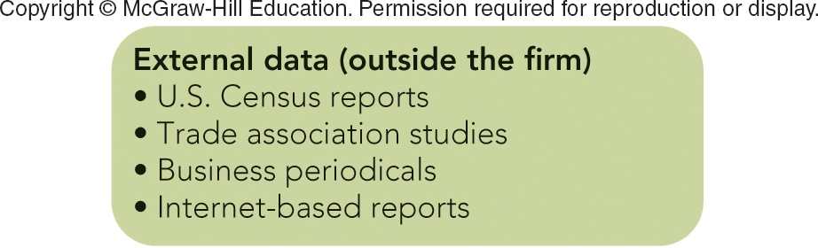
STEP 3: COLLECT RELEVANT DATA SECONDARY DATA (2 of 5)
External
Census Bureau
U. S. 2010 Census
American Community Survey
U. S. 2012 Economic Census
Census Video
Jump to Appendix 4 long image description

Slide 142
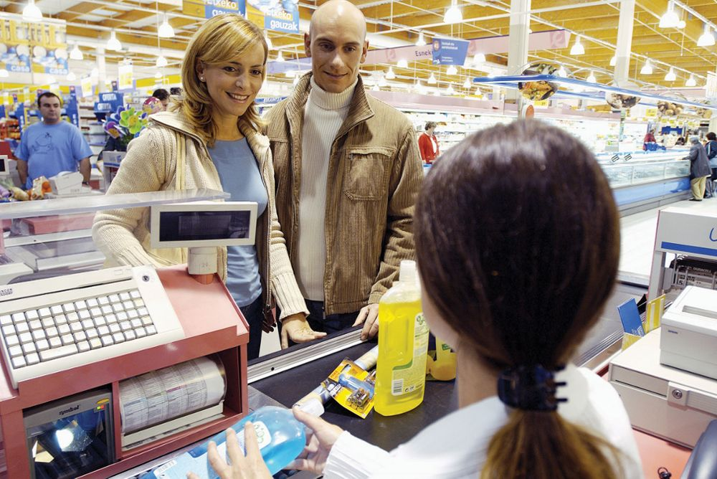
STEP 3: COLLECT RELEVANT DATA SECONDARY DATA (3 of 5)
External
Syndicated Panel
Nielsen TV Ratings
J.D. Power Surveys
IRI InfoScan

Slide 143
STEP 3: COLLECT RELEVANT DATA SECONDARY DATA (4 of 5)
External
Trade Associations
Universities
Business Periodicals

Slide 144
MARKETING MATTERS Online Databases and Internet Resources for Marketers
Sources of News & Articles:
LexisNexis --
CNBC --
Wall Street Journal --
Fox Business --
Sources of Statistical and Financial Data:
FedStats --
Census Bureau --
Portals and Search Engines:
USA.gov --
Google –

Slide 145
STEP 3: COLLECT RELEVANT DATA SECONDARY DATA (5 of 5)
Advantages
Time Savings
Inexpensive
Disadvantages
Out of Date
Definitions/Categories Not Right
Not Specific Enough

Slide 146

STEP 3: COLLECT RELEVANT DATA PRIMARY DATA—WATCHING PEOPLE (1 of 2)
Observational Data
Mechanical Methods
Nielsen’s People Meter
Nielsen’s TV Ratings

Slide 147
FIGURE 7-3 Nielsen Broadcast Ranking Report for network TV primetime households for the week of March 28, 2016.
Rank | Program | Network | Rating | Views (000)
1 | The Big Bang Theory | CBS | 8.8 | 14,238
2 | Dancing with the Stars | ABC | 7.8 | 11,952
3 | Empire | FOX | 7.4 | 12,455
4 | The Voice - Tue | NBC | 6.9 | 11,099
5 | The Voice | NBC | 6.9 | 11,355
6 | Little Big Shots | NBC | 6.7 | 11,329
7 | ACM Awards | CBS | 6.7 | 11,203
8 | NCIS | CBS | 6.6 | 10,381
9 | Blue Bloods | CBS | 6.5 | 10,396
10 | 60 Minutes | CBS | 6.1 | 9,526
Nielsen
Ratings
Source: Nielsen. Primetime Broadcast Programs. Report for the week of March 28, 2016. Viewing estimates include live viewing and DVR playback on the same day, defined as 3 A.M. to 3 A.M. Ratings are the percentage of TV homes in the U.S. tuned into television.

Slide 148

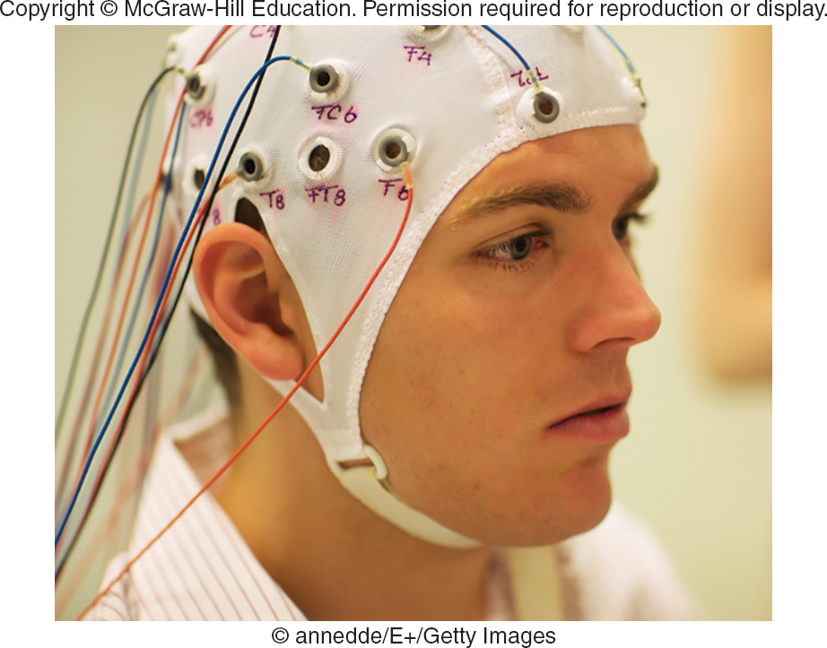
STEP 3: COLLECT RELEVANT DATA PRIMARY DATA—WATCHING PEOPLE (2 of 2)
Personal Methods
Mystery Shopper
Observation
Ethnographic Research
Neuromarketing Methods

Slide 149
STEP 3: COLLECT RELEVANT DATA PRIMARY DATA—ASKING PEOPLE (1 of 3)
Questionnaire Data
Idea Generation Methods – Coming Up with Ideas
Individual Interviews
Depth Interviews

Slide 150
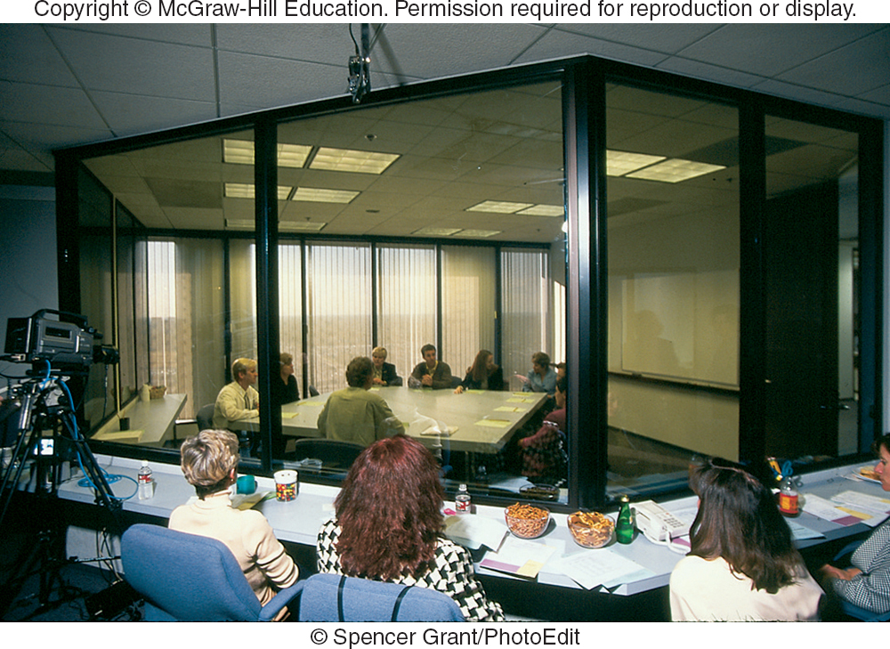
STEP 3: COLLECT RELEVANT DATA PRIMARY DATA—ASKING PEOPLE (2 of 3)
Idea Generation Methods–Coming Up with Ideas
Focus Groups
“The Next Big Thing”
Trend Hunter

Slide 151
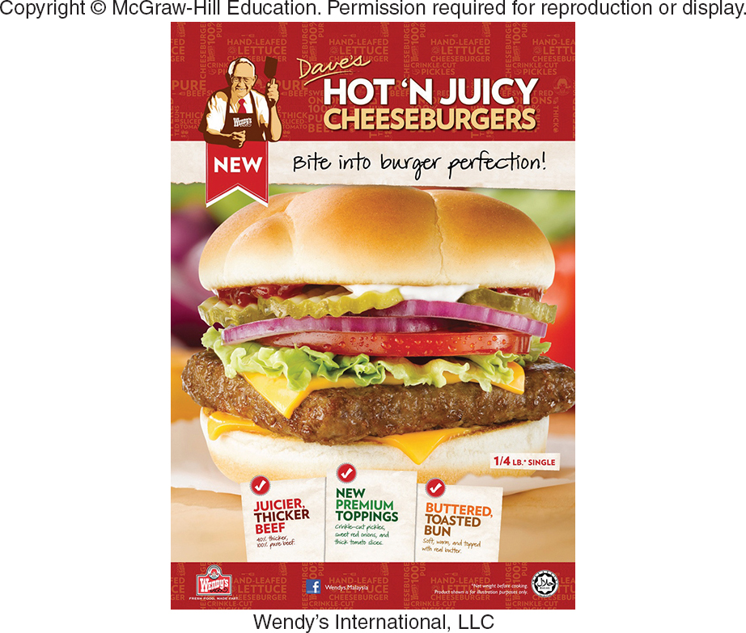
STEP 3: COLLECT RELEVANT DATA PRIMARY DATA—ASKING PEOPLE (3 of 3)
Idea Evaluation Methods – Testing an Idea
Personal Interview Surveys
Telephone Surveys
Mail/Fax Surveys
Online (E-Mail/Internet) Surveys
Mall Intercept Interview Surveys

Slide 152
FIGURE 7-A Comparison of Types of Surveys
BASIS OF COMPARISON | MAIL, ONLINE, & FAX SURVEYS | TELEPHONE SURVEYS | INDIVIDUAL INTERVIEW AND MALL INTERCEPT SURVEYS
Cost per completed survey | Usually the least expensive, assuming adequate response rates | Moderately expensive, assuming reasonable completion rates | Most expensive because of interviewer’s time and travel expenses
Ability to probe and ask complex questions | Little, since self-administered format must be short and simple | Some, since interviewer can probe and elaborate on questions | Much, since interviewer can show visuals, probe, and establish rapport
Opportunity for interviewer to bias results | None, since survey form is completed without the interviewer | Some, because of voice inflection of interviewer | Significant, because of voice and facial expressions of interviewer
Anonymity given to respondents | Complete, since no signature is needed | Some, because of telephone contact | Little, because of face-to-face contact

Slide 153
STEP 3: COLLECT RELEVANT DATA PRIMARY DATA—QUESTION FORMATS
Open-Ended Questions
Closed-End or Fixed Alternative Questions
Dichotomous Questions
Semantic Differential Questions
Likert Scale Questions

Slide 154
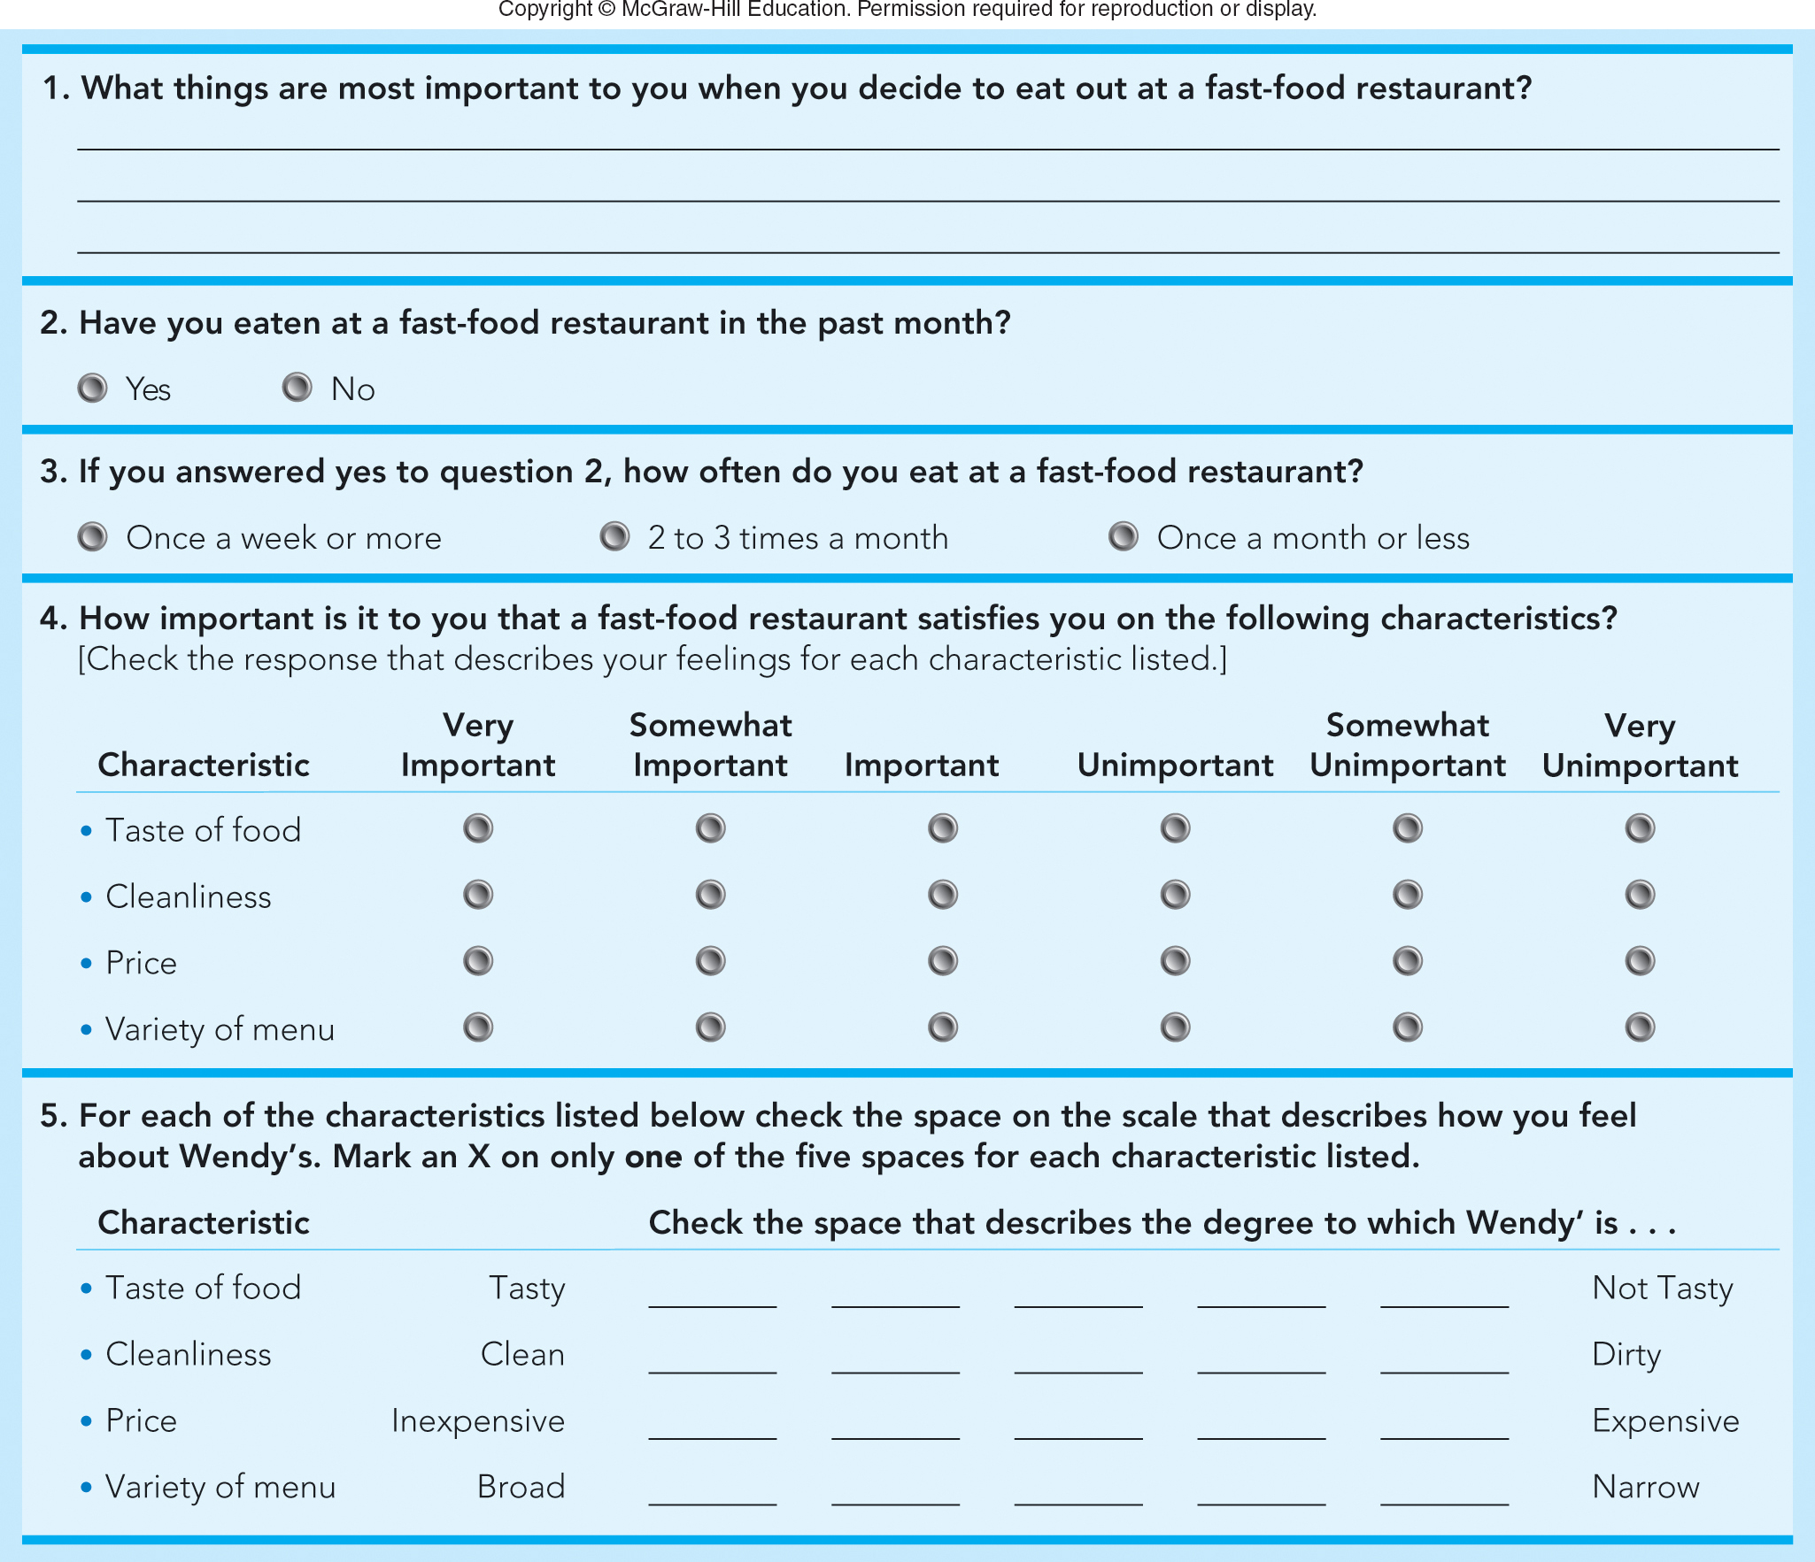
FIGURE 7-4 Different types of questions in a sample Wendy’s survey (Q1 – Q5)
Jump to Appendix 5 long image description

Slide 155
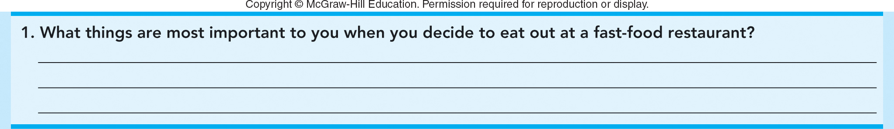
FIGURE 7-4A (Q1) Sample Wendy’s survey: Open-ended question

Slide 156

FIGURE 7-4A (Q2) Sample Wendy’s survey: Dichotomous question

Slide 157

FIGURE 7-4A (Q3) Sample Wendy’s survey: Multiple choice question
Jump to Appendix 6 long image description

Slide 158
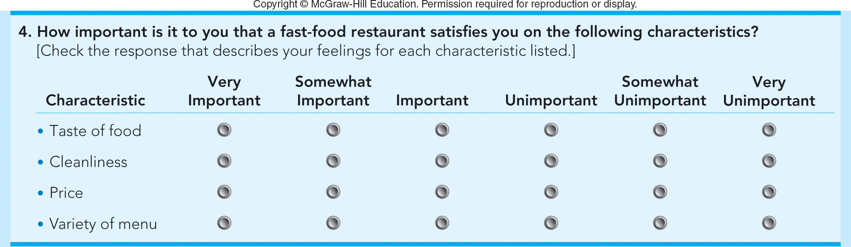
FIGURE 7-4A (Q4) Sample Wendy’s survey: Attitudinal question
Jump to Appendix 7 long image description

Slide 159
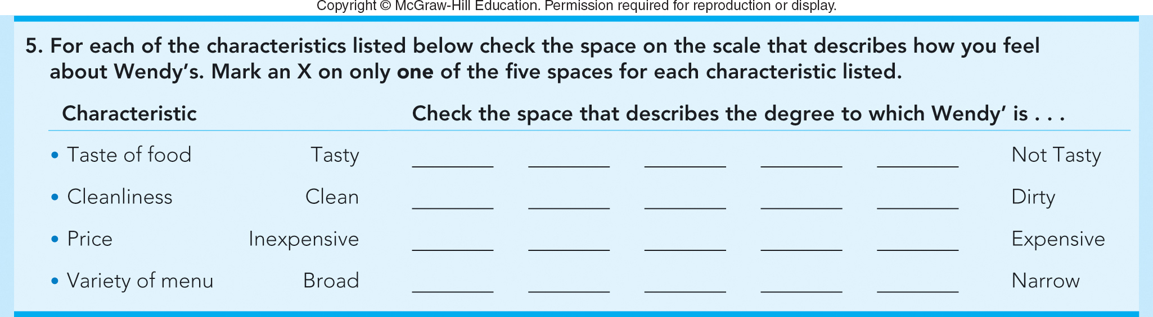
FIGURE 7-4A (Q5) Sample Wendy’s survey: Semantic differential scale question
Jump to Appendix 8 long image description

Slide 160
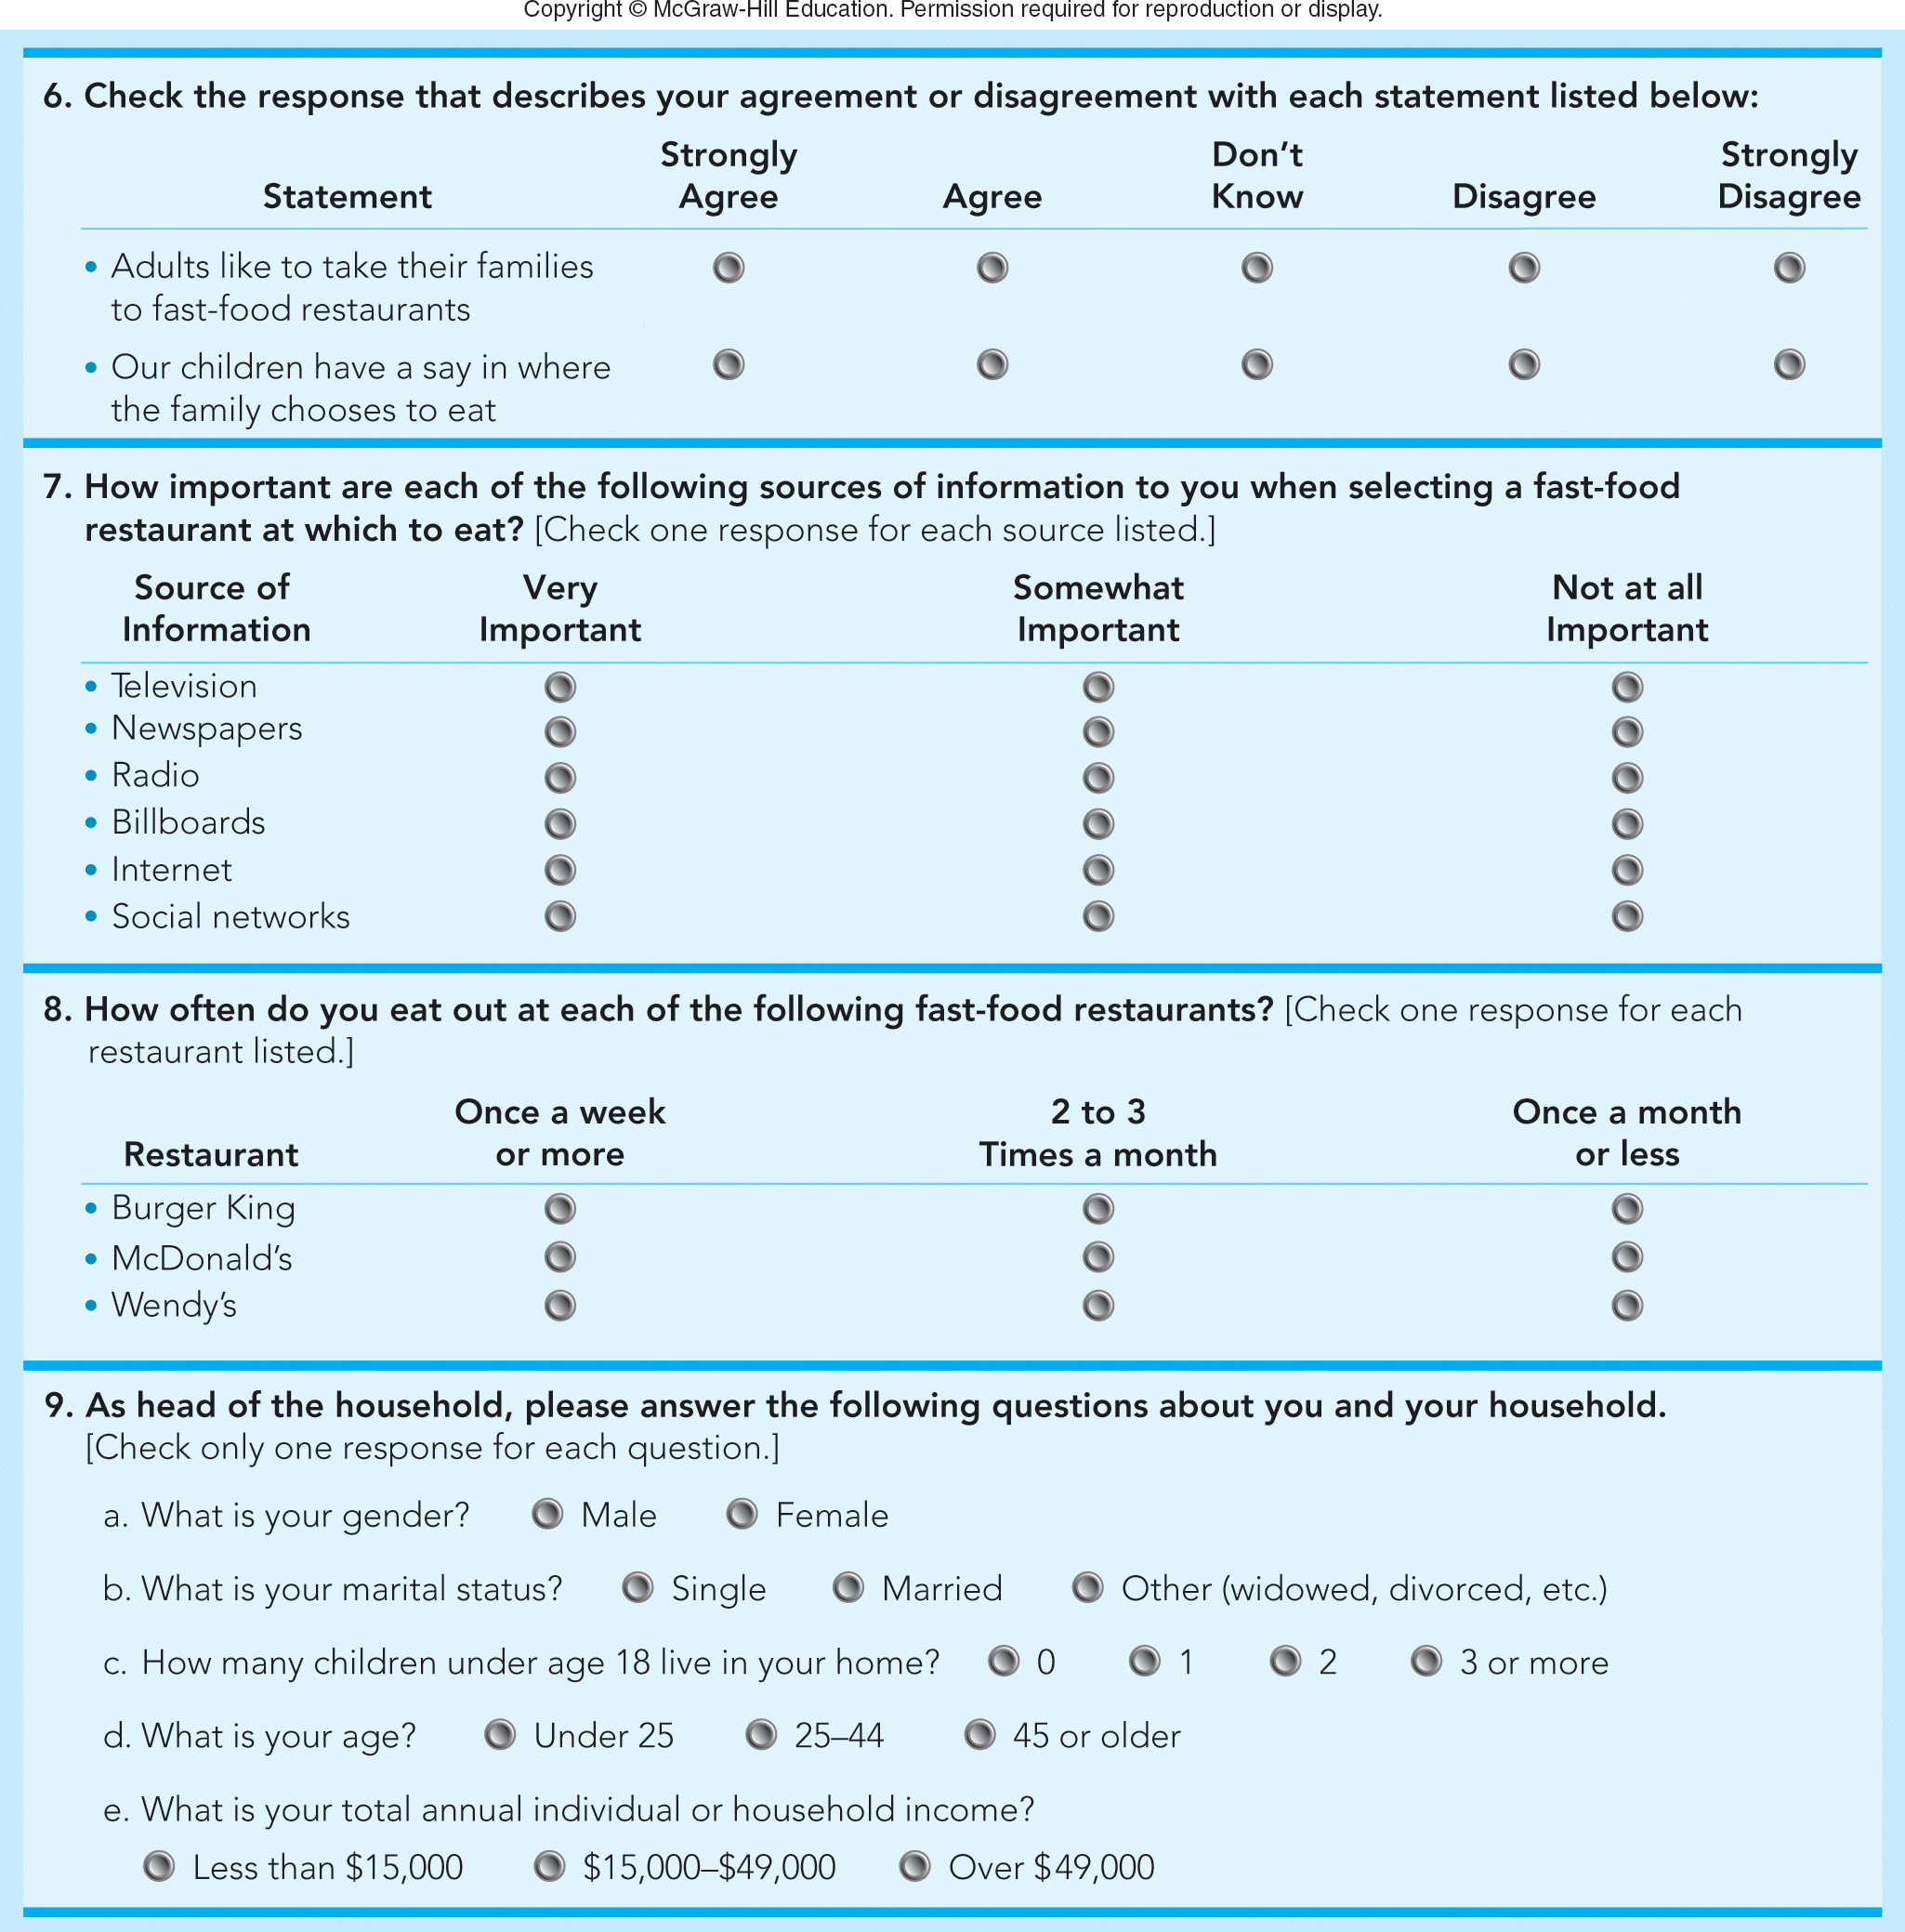
FIGURE 7-4B Different types of questions in a sample Wendy’s survey (Q6 – Q9)
Jump to Appendix 10 long image description

Slide 161
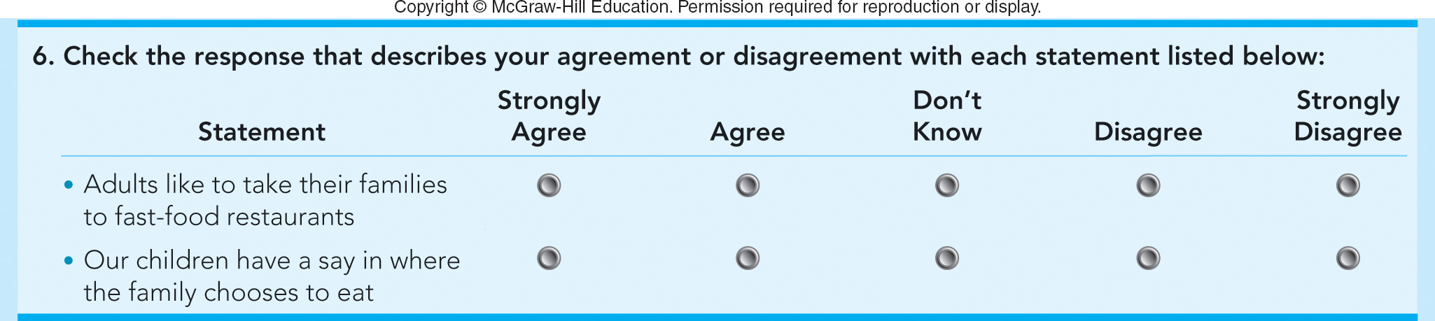
FIGURE 7-4B (Q6) Sample Wendy’s survey: Likert scale question
Jump to Appendix 10 long image description

Slide 162
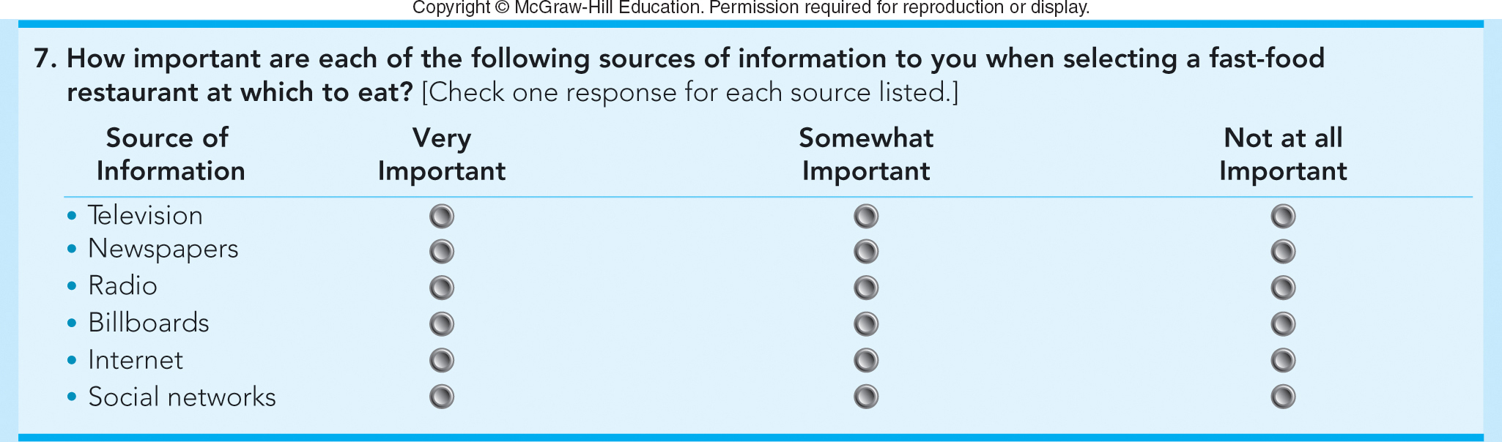
FIGURE 7-4B (Q7) Sample Wendy’s survey: Media behavior question
Jump to Appendix 11 long image description

Slide 163
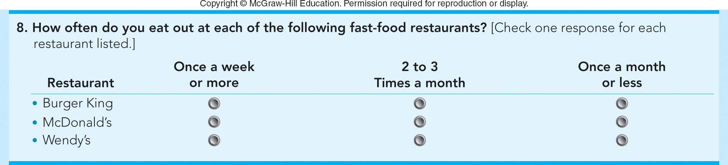
FIGURE 7-4B (Q8) Sample Wendy’s survey: Usage behavior question
Jump to Appendix 12 long image description

Slide 164
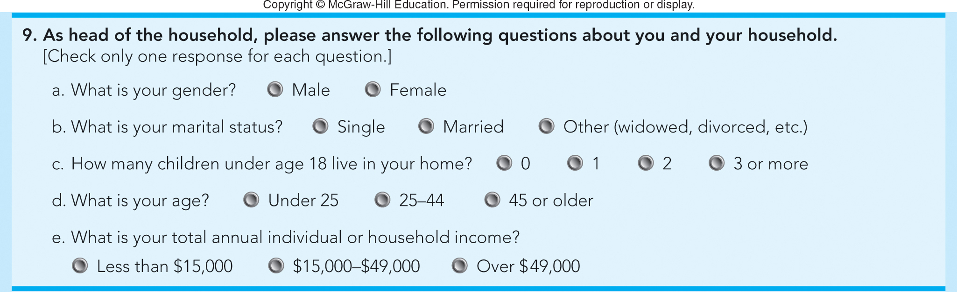
FIGURE 7-4B (Q9) Sample Wendy’s survey: Demographic questions
Jump to Appendix 13 long image description

Slide 165
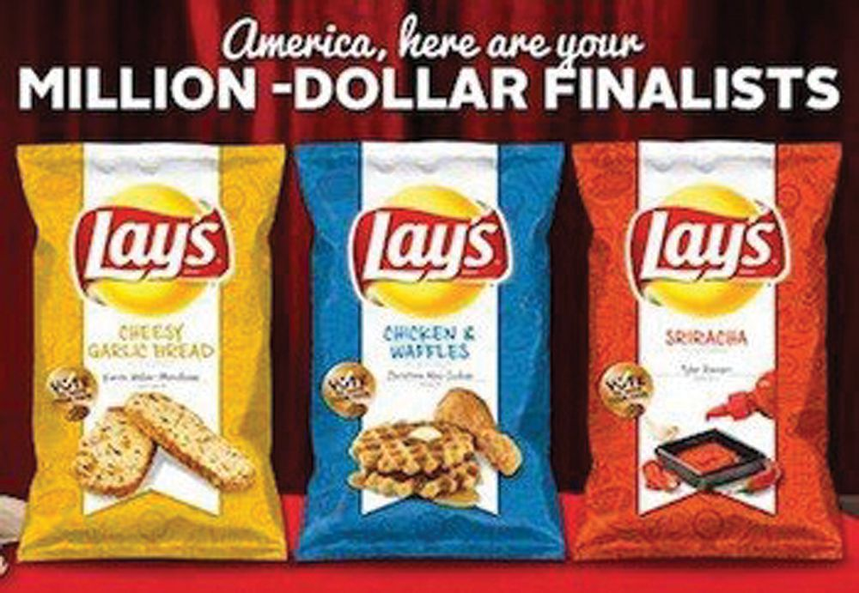
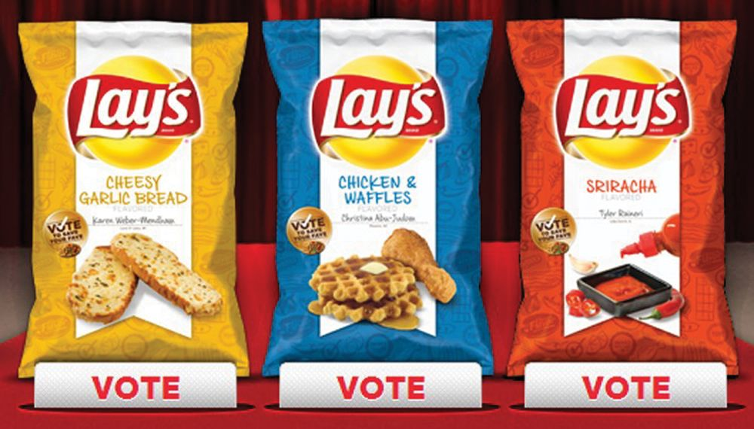
STEP 3: COLLECT RELEVANT DATA PRIMARY DATA—OTHER SOURCES (1 of 2)
Social Media Can Provide Ideas for New Products and Services
Use Social Media Listening Tools

Slide 166
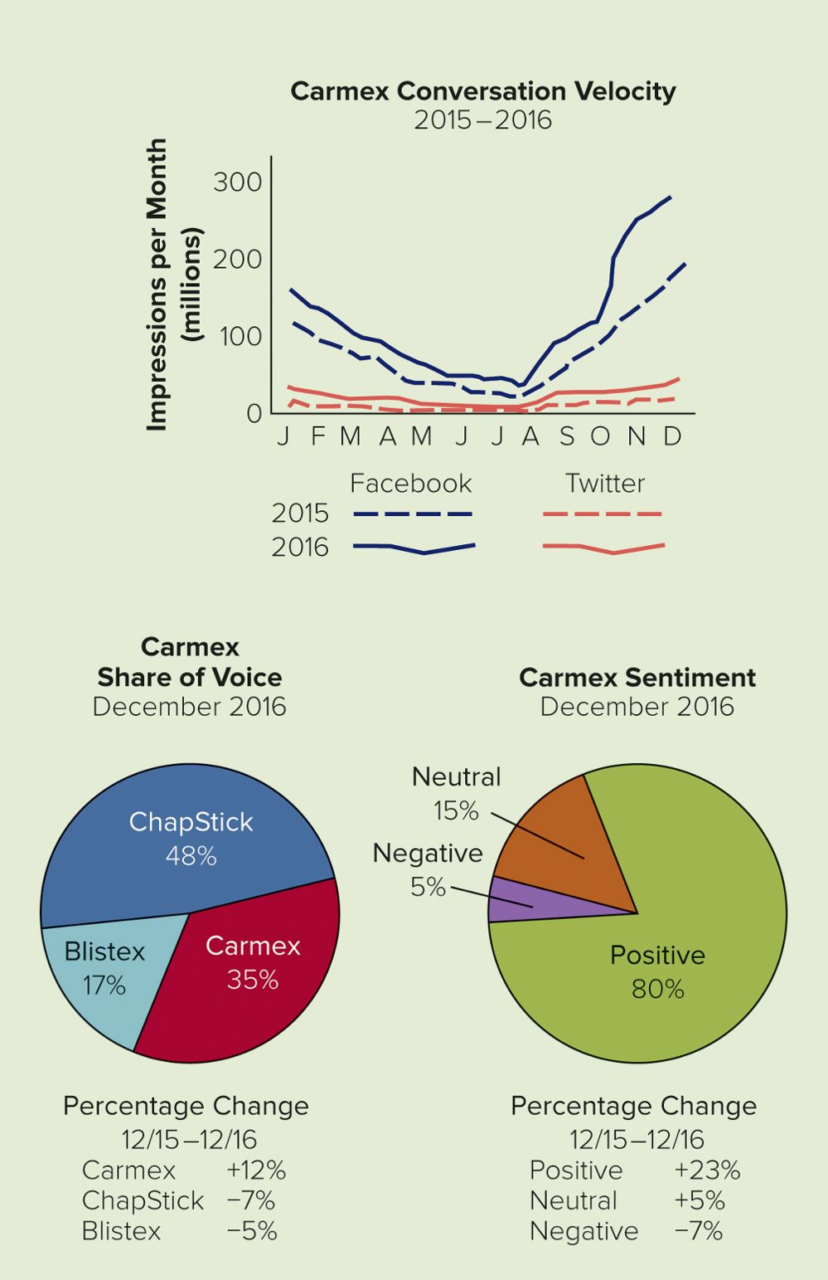
APPLYING MARKETING METRICS Are the Carmex Social Media Programs Working Well?
Conversation
Velocity
Share of Voice
Sentiment
Carmex Lip Balm
Facebook Page
Jump to Appendix 14 long image description

Slide 167
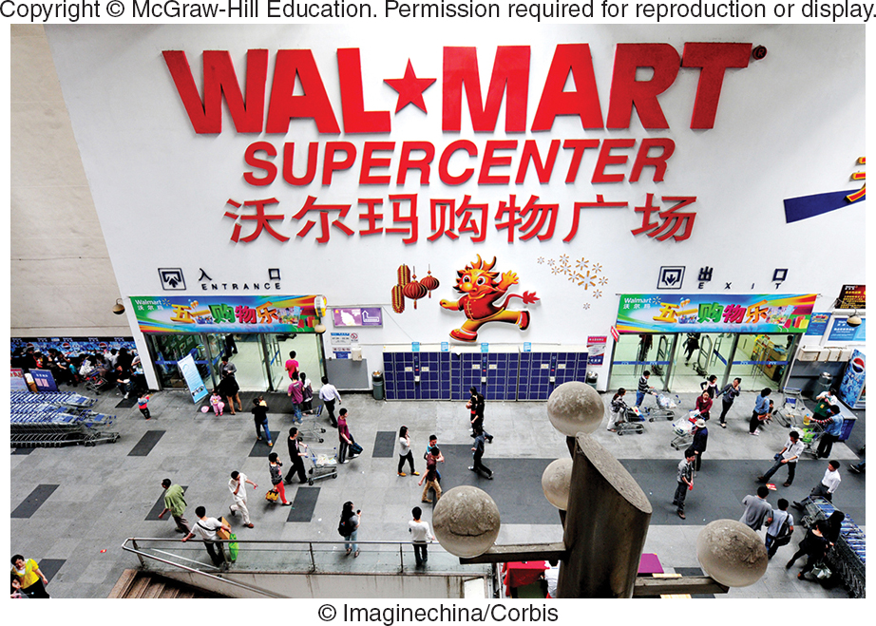
STEP 3: COLLECT RELEVANT DATA PRIMARY DATA—OTHER SOURCES (2 of 2)
Panels
Experiments
Independent Variable: The Cause (Drivers)
Dependent Variable: The Result
Test Markets

Slide 168
STEP 3: COLLECT RELEVANT DATA ADVANTAGES/DISADVANTAGES OF PRIMARY DATA
Advantages
More Flexible
More Specific to the Problem
Disadvantages
Expensive
Time Consuming to Collect

Slide 169

STEP 4: DEVELOP FINDINGS ANALYZE THE DATA
Big Data and Data Analytics
Information Technology
Transform Data into Useful Information
Data Visualization
Intelligent Enterprise
Data Mining
RFID Technology

Slide 170

FIGURE 7-5 How marketing researchers and managers use information technology to turn information into action.
Jump to Appendix 15 long image description

Slide 171
MAKING RESPONSIBLE DECISIONS NO MORE PERSONAL SECRETS: THE DOWNSIDE OF DATA MINING
Reveals Personal Information
Collected via Tracking Devices
(Examples: Cookies and Apps)
Enables Personalization and Targeting
Ghostery
Video

Slide 172

STEP 4: DEVELOP FINDINGS
Analyze the Data
How are Sales?
What Factors Contribute to Sales Trends?
Present the Findings

Slide 173

FIGURE 7-6 Marketing dashboards that present findings to Tony’s marketing manager that lead to recommendations and actions.
Jump to Appendix 16 long image description

Slide 174
STEP 5: TAKE MARKETING ACTIONS
Make Action Recommendations
Implement the Action Recommendations
Evaluate the Results
The Decision Itself
The Decision Process Used

Slide 175

SALES FORECASTING TECHNIQUES (1 of 2)
Sales Forecast
Judgments of the Decision Maker
Direct Forecast
Lost-Horse Forecast
Surveys of Knowledgeable Groups
Survey of Buyers’ Intentions Forecast
Salesforce Survey Forecast

Slide 176
SALES FORECASTING TECHNIQUES (2 of 2)
Statistical Methods
Trend Extrapolation: Extending a Pattern Observed in Past Data into the Future
Linear Trend Extrapolation: When the Pattern is Described with a Straight Line

Slide 177

FIGURE 7-7 Linear trend extrapolation of sales revenues at Xerox, made at the start of 2000. Copyright © McGraw-Hill Education. Permission required for reproduction or display.
Jump to Appendix 17 long image description

Slide 178

VIDEO CASE 7 CARMEX [A]: LEVERAGING FACEBOOK FOR MARKETING RESEARCH
Carmex
Video Case

Slide 179

VIDEO CASE 7 Carmex [A] (1 of 7)
Jump to Appendix 18 long image description

Slide 180

VIDEO CASE 7 Carmex [A] (2 of 7)
Jump to Appendix 19 long image description

Slide 181

FIGURE 3 Potential results from three possible Facebook strategies.
Jump to Appendix 20 long image description

Slide 182
VIDEO CASE 7 Carmex [A] (3 of 7)
What are the advantages and disadvantages for the Carmex marketing team in collecting data to narrow the flavor choices from three to two using (a) an online survey of a cross-section of Internet households or (b) an online survey of Carmex Facebook likers?

Slide 183
VIDEO CASE 7 Carmex [A] (4 of 7)
(a) On a Facebook brand page, what are “engagement” and “likes” really measuring? (b) For Carmex, which is more important and why?

Slide 184
VIDEO CASE 7 Carmex [A] (5 of 7)
(a) What evokes consumers “engagement” on a brand page on Facebook? (b) What attracts consumers to “like” a brand page on Facebook?

Slide 185
VIDEO CASE 7 Carmex [A] (6 of 7)
(a) What are the advantages of using a fixed-alternative poll question on Facebook? (b) When do you think it would be better to use an open-ended question?

Slide 186
VIDEO CASE 7 Carmex [A] (7 of 7)
(a) If you had a limited budget and two weeks to decide which two flavors to put into quantitative testing, would you choose a “poll only” or a “contest only” strategy? Why? (b) If you had a sizeable budget and two months to make the same decision, which scenario would you choose? Why?

Slide 187
IN-CLASS ACTIVITY 7-1
INTERPRETING CENSUS DATA

Slide 188
ICA 7-1 Interpreting Census Data
Learn How Census Data is Collected
Locate Specific Data
Identify Size of Market Segments
US Census
Web Site
Census Promotional Video
ACS Promotional Video

Slide 189
IN-CLASS ACTIVITY 7-2
WEBSITES FOR MARKETERS

Slide 190
ICA 7-2 Websites for Marketers
American Marketing Association
American Advertising Federation
The Wall Street Journal
Drudge Report
Bloomberg Businessweek
Fox Business
CNBC
YouTube
Google
eBay
Amazon.com
USA.gov

Slide 191
IN-CLASS ACTIVITY 7-3
DESIGNING A TASTE TEST SURVEY FOR HOWLIN’ COYOTE CHILI

Slide 192

Howlin design survey.

Slide 193
IN-CLASS ACTIVITY 7-4
PEPSI VS. COKE TASTE TEST

Slide 194
ICA 7-4 Pepsi vs. Coke Taste Test Challenge
Pepsi vs. Coke Taste Test Challenge
Pepsi Taste Test Ad
Coke Taste Test Ad

Slide 195
Marketing Research
Marketing research is the process of defining a marketing problem and opportunity, systematically collecting and analyzing information, and recommending actions.

Slide 196
Measures of Success
Measures of success are criteria or standards used in evaluating proposed solutions to the problem.

Slide 197
Constraints
Constraints are, in a decision, the restrictions placed on potential solutions to a problem.

Slide 198
Data
Data are the facts and figures related to the project that are divided into two main parts: secondary data and primary data.

Slide 199
Secondary Data
Secondary data are the facts and figures that have already been recorded prior to the project at hand.

Slide 200
Primary Data
Primary data are the facts and figures that are newly collected for the project.

Slide 201
Observational Data
Observational data are the facts and figures obtained by watching, either mechanically or in person, how people actually behave.

Slide 202
Questionnaire Data
Questionnaire data are the facts and figures obtained by asking people about their attitudes, awareness, intentions, and behaviors.

Slide 203
Information Technology
Information technology involves operating computer networks that can store and process data.

Slide 204
Sales Forecast
A sales forecast consists of the total sales of a product that a firm expects to sell during a specified time period under specified environmental conditions and its own marketing efforts.

Slide 205
Appendix 1 FIGURE 7-1 Five-step marketing research approach leading to marketing actions
Step 1 define the problem. Set research objectives. Identify possible marketing actions.
Step 2 develop the research plan. Specify constraints. Identify data needed for marketing actions. Determine how to collect data.
Step 3 collect relevant information. Obtain secondary data. Obtain primary data.
Step 4 develop findings. Analyze the data present. Present the findings.
Step 5 take marketing actions. Make action recommendations. Implement action recommendations. Evaluate results.
Each step also utilizes feedback to learn lessons for future research.
Return to slide

Slide 206
Appendix 2 FIGURE 7-2 Types of marketing information
Data (facts and figures pertinent to the project) divides into two data branches. The first data branch is primary data (facts and figures newly collected for the project). This further breaks down into three types of data:
1. Observational data (watching people). Mechanical methods. Personal methods. Neuromarketing methods.
2. Questionnaire data (asking people). Idea generation methods. Idea evaluation methods.
3. Other sources of data. Social media. Panels and experiments. Information technology. Data mining.
The second data branch is secondary data (facts and figures already recorded prior to the project). This further breaks down into two types of data:
1. Internal data (inside the firm). Inputs (budgets, financial statements, sales call reports). Outcomes (actual sales and customer communications).
2. External data (outside the firm). U.S. Census reports. Trade association studies. Business periodicals. Internet-based reports.
Return to slide

Slide 207
Appendix 3 STEP 3: COLLECT RELEVANT DATA SECONDARY DATA (1 of 5)
The two aspects of internal data (inside the firm) are inputs (budgets, financial statements, sales call reports) and outcomes (actual sales and customer communications).
Return to slide

Slide 208
Appendix 4 STEP 3: COLLECT RELEVANT DATA SECONDARY DATA (2 of 5)
The types of external data (outside the firm) are: U.S. census reports, trade association studies, business periodicals, and Internet-based reports.
Return to slide

Slide 209
Appendix 5 FIGURE 7-4A Different types of questions in a sample Wendy’s survey (Q1 – Q5)
1. What things are most important to you when you decide to eat out at a fast-food restaurant?
2. Have you eaten at a fast-food restaurant in the past month? Yes. No.
3. If you answered yes to question 2, how often do you eat at a fast-food restaurant? Once a week or more. 2 to 3 times a month. Once a month or less.
4. How important is it to you that a fast-food restaurant satisfies you on the following characteristics? Check the response that describes your feelings for each characteristic listed.
Taste of food, cleanliness, price, variety of menu.
(a range is offered: very important, somewhat important, unimportant, somewhat unimportant, very unimportant. These are to be used as answers in response to the characteristics).
5. For each of the characteristics listed below, check the space on the scale that describes how you feel about Wendy's Mark an X on only one of the five spaces for each characteristic listed.
Taste of food (five blank spaces sit between the word "tasty" and the words "not tasty").
Cleanliness (five blank spaces sit between the word "clean" and the word "dirty").
Price (five blank spaces sit between the word "inexpensive" and the word "expensive").
Variety of menu (five blank spaces sit between the word "broad" and the word "narrow").
Return to slide

Slide 210
Appendix 6 FIGURE 7-4A (Q3) Sample Wendy’s survey: Multiple choice question
3. If you answered yes to question 2, how often do you eat at a fast-food restaurant? Once a week or more. 2 to 3 times a month. Once a month or less.
Return to slide

Slide 211
Appendix 7 FIGURE 7-4A (Q4) Sample Wendy’s survey: Attitudinal question
4. How important is it to you that a fast-food restaurant satisfies you on the following characteristics? Check the response that describes your feelings for each characteristic listed.
Taste of food, cleanliness, price, variety of menu.
(A range is offered: very important, somewhat important, unimportant, somewhat unimportant, very unimportant. These are to be used as answers in response to the characteristics.)
Return to slide

Slide 212
Appendix 8 FIGURE 7-4A (Q5) Sample Wendy’s survey: Semantic differential scale question
5. For each of the characteristics listed below, check the space on the scale that describes how you feel about Wendy's Mark an X on only one of the five spaces for each characteristic listed.
Taste of food (five blank spaces sit between the word "tasty" and the words "not tasty").
Cleanliness (five blank spaces sit between the word "clean" and the word "dirty").
Price (five blank spaces sit between the word "inexpensive" and the word "expensive").
Variety of menu (five blank spaces sit between the word "broad" and the word "narrow").
Return to slide

Slide 213
Appendix 9 FIGURE 7-4B Different types of questions in a sample Wendy’s survey (Q6 – Q9)
6. Check the response that describes your agreement or disagreement with each statement listed below:
Adults like to take their families to fast-food restaurants (strongly agree, agree, don't know, disagree, strongly disagree).
Our children have a say in where the family chooses to eat (strongly agree, agree, don't know, disagree, strongly disagree).
7. How important are each of the following sources of information to you when selecting a fast-food restaurant at which to eat. Check one response for each source listed.
Television (very important, somewhat important, not at all important).
Newspapers (very important, somewhat important, not at all important).
Radio (very important, somewhat important, not at all important).
Billboards (very important, somewhat important, not at all important).
Internet (very important, somewhat important, not at all important).
Social networks (very important, somewhat important, not at all important).
8. How often do you eat out at each of the following fast-food restaurants? Check one response for each restaurant listed.
Burger King (once a week or more, 2 to 3 times a month, once a month or less).
McDonald's (once a week or more, 2 to 3 times a month, once a month or less).
Wendy's (once a week or more, 2 to 3 times a month, once a month or less).
9. As head of the household, please answer the following questions about you and your household. Check only on response for each question.
a. What is your gender? Male. Female.
b. What is your marital status? Single. Married. Other (widowed, divorced, etc.)
c. How many children under age 18 live in your home? 0. 1. 2. 3 or more.
d. What is your age? Under 25. 25-44. 45 or older.
e. What is your total annual individual or household income? Less than 15 thousand dollars. 15 thousand dollars to 49 thousand dollars. Over 49 thousand dollars.
Return to slide

Slide 214
Appendix 10 FIGURE 7-4B (Q6) Sample Wendy’s survey: Likert scale question
6. Check the response that describes your agreement or disagreement with each statement listed below:
Adults like to take their families to fast-food restaurants (strongly agree, agree, don't know, disagree, strongly disagree).
Our children have a say in where the family chooses to eat (strongly agree, agree, don't know, disagree, strongly disagree).
Return to slide

Slide 215
Appendix 11 FIGURE 7-4B (Q7) Sample Wendy’s survey: Media behavior question
7. How important are each of the following sources of information to you when selecting a fast-food restaurant at which to eat. Check one response for each source listed.
Television (very important, somewhat important, not at all important).
Newspapers (very important, somewhat important, not at all important).
Radio (very important, somewhat important, not at all important).
Billboards (very important, somewhat important, not at all important).
Internet (very important, somewhat important, not at all important).
Social networks (very important, somewhat important, not at all important).
Return to slide

Slide 216
Appendix 12 FIGURE 7-4B (Q8) Sample Wendy’s survey: Usage behavior question
8. How often do you eat out at each of the following fast-food restaurants? Check one response for each restaurant listed.
Burger King (once a week or more, 2 to 3 times a month, once a month or less).
McDonald's (once a week or more, 2 to 3 times a month, once a month or less).
Wendy's (once a week or more, 2 to 3 times a month, once a month or less).
Return to slide

Slide 217
Appendix 13 FIGURE 7-4B (Q9) Sample Wendy’s survey: Demographic questions
9. As head of the household, please answer the following questions about you and your household. Check only on response for each question.
a. What is your gender? Male. Female.
b. What is your marital status? Single. Married. Other (widowed, divorced, etc.)
c. How many children under age 18 live in your home? 0. 1. 2. 3 or more.
d. What is your age? Under 25. 25-44. 45 or older.
e. What is your total annual individual or household income? Less than 15 thousand dollars. 15 thousand dollars to 49 thousand dollars. Over 49 thousand dollars.
Return to slide

Slide 218
Appendix 14 APPLYING MARKETING METRICS Are the Carmex Social Media Programs Working Well?
The first is a line graph showing the Carmex conversation velocity by comparing the month and the number of impressions per month in millions. The graph looks at both 2015 and 2016 and compares Facebook and Twitter. Looking at the Facebook line, 2015 and 2016 are very similar, both being at about 110 million and 150 million respectively in January. From there, they dip down to about 30 million (2015) and 50 million (2016) in June and July, and rise back up to approximately 190 million in 2015 and 290 million in 2016. When looking at the Twitter lines, 2015 began at approximately 10 million and 2016 began at 20 million. These lines stayed relatively straight for the entire year rising very slightly towards September, October, November, and December.
The second graph is a pie chart called Carmex Share of Voice December 2016. Chapstick is 48 percent of the graph, Blistex is 17 percent, and Carmex is 35 percent. The percentage change from 12/15 to 12/16 is Carmex +12 percent, Chapstick -7 percent, and Blistex -5 percent.
The final graph is a pie chart titled Carmex Sentiment December 2016. 80 percent of the graph is positive, 5 percent is negative, and 15 percent is neutral. The percentage change for this graph from 12/15 to 12/16 is positive +23 percent, neutral +5 percent, and negative -7 percent.
Return to slide

Slide 219
Appendix 15 FIGURE 7-5 How marketing researchers and managers use information technology to turn information into action
The intelligent marketing enterprise platform is broken into big data and data analytics.
Big data contains the following:
Internal data sources (customer orders, customer data, inventory, sales calls, promotions).
Cloud environment (data storage, cloud computing capabilities).
External data sources (global sources, trade associations, U.S. Census data, Internet of things, single-source services).
These all connect to a data warehouse, which contains internal and external databases.
With data analytics, analytical tools to organize, manipulate, analyze, and present data are used to create results, which are examined by a marketing researcher or data scientist to answer buying queries such as "who buys?" and "How much?" and "why?" These results are analyzed again before being sent into the internal and external databases.
Return to slide

Slide 220
Appendix 16 FIGURE 7-6 Marketing dashboards that present findings to Tony’s marketing manager that lead to recommendations and actions
The four bar graphs show the following:
Bar graph A annual sales:
Bar graph B annual sales per household:
Bar graph C average annual sales per household, by household size.
Bar graph D average annual sales per household, by age of children in the household.
Return to slide

Slide 221
Appendix 17 FIGURE 7-7 Linear trend extrapolation of sales revenues at Xerox, made at the start of 2000
A line graph of sales revenues (in billions) over the years between 1988 and 2018 shows an incline from about 12 billion dollars in 1988 to just under 18 billion dollars in 2000. These actual values include a high of 20 billion dollars in 1998, and a drop between 1992 and 1994. The linear trend extrapolation forecast shows a continued steady incline from 2000 to 2018.
The actual values after the forecast is made shows a drop in sales revenue from 2000. It reaches a steady low of 16 billion dollars between 2002 and 2005. A slight increase occurs between 2006 and 2008, before a drop in 2009 reaches a low of 15 billion dollars. 2010 shows a sharp increase, with a high in 2011 of 22 billion dollars. The line declines slightly before dropping down to 16 billion dollars in 2016.
Return to slide

Slide 222
Appendix 18 VIDEO CASE 7 Carmex [A] (1 of 7)
The question asks, “Which Carmex lip balm flavor would you most like to see next: watermelon, green apple, or peach mango?”
Below this are the options to like and comment.
Return to slide

Slide 223
Appendix 19 VIDEO CASE 8 Carmex [A]
The question asks, “Which Carmex lip balm flavor would you most like to see next?” Beneath it are the options of watermelon, green apple, or peach mango.
Return to slide

Slide 224
Appendix 20 FIGURE 3 Potential results from three possible Facebook strategies
Three Facebook strategies are shown, as well as their potential impacts, and whether the results are favorable, neutral, or unfavorable.
Poll only. Potential increased "engagement“: high (favorable). Potential increased "likes“: low (unfavorable). Cost: low (unfavorable).
Contest only. Potential increased "engagement“: low (unfavorable). Potential increased "likes“: high (favorable). Cost: moderate (neutral).
Poll and Contest. Potential increased "engagement“: high (favorable). Potential increased "likes“: high (favorable). Cost: moderate to high (neutral).
Return to slide

Slide 226

Market Segmentation, Targeting, and Positioning

Slide 227
LEARNING OBJECTIVES (LO) AFTER READING CHAPTER 8, YOU SHOULD BE ABLE TO: (1 of 2)
1. Explain what market segmentation is and when to use it.
2. Identify the five steps involved in segmenting and targeting markets.
3. Recognize the bases used to segment consumer and organizational (business) markets.

Slide 228
LEARNING OBJECTIVES (LO) AFTER READING CHAPTER 8, YOU SHOULD BE ABLE TO: (2 of 2)
4. Develop a market-product grid to identify a target market and recommend resulting marketing actions.
5. Explain how marketing managers position products in the marketplace.

Slide 229

WHY SEGMENT MARKETS? WHAT MARKET SEGMENTATION MEANS
Market Segmentation
Market Segments
Product Differentiation
Segmentation: Linking Needs to Actions
The Zappos Segmentation Strategy
Zappos
Website

Slide 230

FIGURE 8-1 Market segmentation links market needs to an organization’s marketing program through marketing mix actions.
Jump to Appendix 1 long image description

Slide 231

FIGURE 8-2 A market-product grid shows the kind of sleeper that is targeted for each of the bed pillows with a different firmness.
Using Market-Product Grids
Jump to Appendix 2 long image description

Slide 232
WHY SEGMENT MARKETS? WHEN AND HOW TO SEGMENT MARKETS (1 of 2)
One-Size-Fits-All Mass Markets No Longer Exist
Three Segmentation Strategies:
One Product and Multiple Market Segments (Ex: Books)
Multiple Products and Multiple Market Segments (Ex: Cars)
Segments of One–“Mass Customization” (Ex: Tailor Products to Individuals)

Slide 233

Sporting News Baseball Yearbook What market segmentation strategy is used?
Sporting News Baseball
Yearbook Website
Jump to Appendix 3 long image description

Slide 234


WHY SEGMENT MARKETS? WHEN AND HOW TO SEGMENT MARKETS (2 of 2)
The Segmentation Tradeoff: Synergies vs. Cannibalization
Organizational Synergy
Cannibalization
“Tiffany/Walmart” Strategies (2-Tier)

Slide 235
SEGMENTING AND TARGETING MARKETS STEP 1: GROUP POTENTIAL BUYERS INTO SEGMENTS (1 of 5)
Criteria to Use in Forming the Segments
Similarity of Needs of Potential Buyers within a Segment
Potential for Increased Profit
Difference of Needs of Buyers among Segments

Slide 236

FIGURE 8-3 The five key steps in segmenting and targeting markets that link market needs to a firm's marketing program.
Jump to Appendix 4 long image description

Slide 237

SEGMENTING AND TARGETING MARKETS STEP 1: GROUP POTENTIAL BUYERS INTO SEGMENTS (2 of 5)
Criteria to Use in Forming the Segments
Simplicity and Cost-Effectiveness
Potential for Increased Profit
Similarity of Buyers’ Needs
Difference of Needs of Buyers
Potential of Reaching Segment

Slide 238
SEGMENTING AND TARGETING MARKETS STEP 1: GROUP POTENTIAL BUYERS INTO SEGMENTS (3 of 5)
Ways to Segment Consumer Markets:
Geographic Segmentation: Region (88%)
Behavioral Segmentation: Product Features (65%)
Demographic Segmentation: Household Size (53%)
Psychographic Segmentation: Lifestyle (43%)
Usage Rate: The 80/20 Rule

Slide 239

FIGURE 8-4 Comparison of various kinds of users and nonusers for Wendy’s, Burger King, and McDonald’s fast-food restaurants.
Source: Experian Marketing Services Simmons Winter 2013 Full Year Adult Survey 12-Month OneViewSM Crosstabulation Report: Based on Visits within the Past 30 Days
Jump to Appendix 5 long image description

Slide 240
SEGMENTING AND TARGETING MARKETS STEP 1: GROUP POTENTIAL BUYERS INTO SEGMENTS (4 of 5)
Variables to Use in Forming Segments for Wendy’s
Students:
Dorms, Sororities, and Fraternities
Apartments
Day Commuters
Night Commuters
Nonstudents:
Faculty and Staff
Residents in Area
Workers in Area

Slide 241

SEGMENTING AND TARGETING MARKETS STEP 1: GROUP POTENTIAL BUYERS INTO SEGMENTS (5 of 5)
Ways to Segment Organizational Markets
Geographic Segmentation: Statistical Area
Demographic Segmentation:
By NAICS Code
By Number of Employees
Behavioral Segmentation: Usage Rate

Slide 242
SEGMENTING AND TARGETING MARKETS STEP 2: GROUP PRODUCTS INTO CATEGORIES
Individual Wendy’s Products
Groupings of Wendy’s Products: Meals
Breakfast
Lunch
Between Meal Snack
Dinner
After Dinner Snack
Wendy’s Ad

Slide 243

FIGURE 8-5 Wendy’s new products and innovations target specific market segments based on a customer’s gender, needs, or university affiliation.
Jump to Appendix 6 long image description

Slide 244

SEGMENTING AND TARGETING MARKETS STEP 3: DEVELOP A MARKET-PRODUCT GRID AND ESTIMATE THE SIZE OF MARKETS
Forming a Market-Product Grid
Estimating Market Sizes

Slide 245

FIGURE 8-6 Selecting a target market for your Wendy’s fast-food restaurant next to an urban university (target market is shaded).
Jump to Appendix 7 long image description

Slide 246
SEGMENTING AND TARGETING MARKETS STEP 4: SELECT TARGET MARKETS (1 of 3)
Criteria to Use in Selecting Target Markets
Two Types of Criteria:
Those That Divide a Market into Segments
Those That Actually Pick the Target Segments

Slide 247
SEGMENTING AND TARGETING MARKETS STEP 4: SELECT TARGET MARKETS (2 of 3)
Criteria to Use in Selecting Target Markets
Market Size
Expected Growth
Competitive Position
Cost of Reaching the Segment
Organizational Compatibility

Slide 248
SEGMENTING AND TARGETING MARKETS STEP 4: SELECT TARGET MARKETS (3 of 3)
Choose the Products and Segments
No Breakfast
Four Student Segments Only
Not the Three Nonstudent Segments

Slide 249

SEGMENTING AND TARGETING MARKETS STEP 5: TAKE MARKETING ACTIONS (1 of 2)
Wendy’s Immediate Segmentation Strategy
Day Commuters
Between-Meal Snacks
Dinners to Night Commuters
Keeping an Eye on Competition
Future Strategies for Wendy’s?

Slide 250

MARKETING MATTERS Apple’s Segmentation Strategy
Jump to Appendix 8 long image description

Slide 251


SEGMENTING AND TARGETING MARKETS STEP 5: TAKE MARKETING ACTIONS (2 of 2)
Apple's Ever-Changing Segmentation Strategy
Market-Product Synergies: A Balancing Act
Marketing Synergies
Product Synergies
Apple’s 1984 Super Bowl Ad

Slide 252

POSITIONING THE PRODUCT (1 of 3)
Product Positioning
Product Repositioning
Two Approaches to Product Positioning
Head-to-Head Positioning
Differentiation Positioning
Crafting a Formal Positioning Statement

Slide 253
POSITIONING THE PRODUCT (2 of 3)
Product Positioning Using Perceptual Maps
Identify Important Attributes for a Product or Brand Class
Customers’ Ratings of Competing Products or Brands on These Attributes
Customers’ Ratings of the Company’s Products or Brands on These Attributes
Reposition the Company’s Products or Brands in the Minds of Consumers

Slide 254

POSITIONING THE PRODUCT (3 of 3)
Perceptual Map
A Perceptual Map to Reposition Chocolate Milk for Adults
Identify Important Attributes for Adult Drinks
Discover How Adults See Competing Drinks
Discover How Customers See Chocolate Milk
Reposition Chocolate Milk to Make It More Appealing to Adults

Slide 255

FIGURE 8-7 The strategy American dairies are using to reposition chocolate milk to reach adults.
Jump to Appendix 9 long image description

Slide 256

VIDEO CASE 8 PRINCE SPORTS, INC.: TENNIS RACQUETS FOR EVERY SEGMENT
Prince Video Case

Slide 257
FIGURE 1 Prince targets racquets at specific market segments
Main Segments | Subsegment | Characteristics | Brand Name | Length (Inches) | Unstrung Weight (Ounces) | Head Size (Sq. In.)
Performance | Precision | Touring professional players | EXO3 Ignite 95 | 27.0 | 11.8 | 95
 | Thunder | Competitive players | EXO3 Red 95 | 27.25 | 9.9 | 105
Recreational | Small head size | Forgiving racquet with added control | AirO Lightning MP | 27.0 | 9.9 | 100
 | Larger head size | Larger sweet spot and added power | AirO Maria Lite OS | 27.0 | 9.7 | 110
Junior | More experiences young players | Ages 8-15 Shorter and lighter racquet | AirO Team Maria 23 | 23.0 | 8.1 | 100
 | Beginner | Ages 5-11 Much shorter and lighter racquet | Air Team Maria 19 | 19.0 | 7.1 | 82

Slide 258
VIDEO CASE 9 Prince Sports (1 of 5)
In the 21st century, what trends in the environmental forces (social, economic, technological, competitive, and regulatory) (a) work for and (b) work against success for Prince Sports in the tennis industry?

Slide 259
VIDEO CASE 9 Prince Sports (2 of 5)
Because sales of Prince Sports in tennis-related products depends heavily on growth of the tennis industry, what marketing activities might it use in the United States to promote tennis playing?

Slide 260
VIDEO CASE 9 Prince Sports (3 of 5)
What promotional activities might Prince use to reach (a) recreational players and (b) junior players?

Slide 261
VIDEO CASE 9 Prince Sports (4 of 5)
What might Prince do to gain distribution and sales in (a) mass merchandisers like Target and Walmart and (b) specialty tennis shops?

Slide 262
VIDEO CASE 9 Prince Sports (5 of 5)
In reaching global markets outside the U.S., (a) what are some criteria that Prince should use to select countries in which to market aggressively, (b) what three or four countries meet these criteria best, and (c) what are some marketing actions Prince might use to reach these markets?

Slide 263
IN-CLASS ACTIVITY 8-1
HONEY NUT CHEERIOS® MILK ‘N CEREAL BAR: IDENTIFYING PRODUCT GROUPS

Slide 264
ICA 8-1 Honey Nut Cheerios® Milk ‘N Cereal Bar
Discover process of categorization and how different people categorize the same objects in different ways.
Explore some of the reasons for these differences.
Understand the importance of categorization in identifying both market segments and competitors.

Slide 265
IN-CLASS ACTIVITY 8-2
3M POST-IT® FLAG + HIGHLIGHTER: PRODUCT POSITIONING FOR CONSUMERS AND RETAILERS

Slide 266
ICA 8-2 3M Post-it® Flag Highlighter Invention
Study 3M Flag Highlighters
Suggest Consumer Benefits and Retailer Benefits
Compose a Product Positioning Statement that Links it to 3M’s Branding Strategy for the Product
3M Post-it Flag
Highlighter Ad
3M Post-it Flag
Highlighter Website

Slide 267

Product and Branding Handout

Slide 268

Product and Branding Answers Handout

Slide 269
Market Segmentation
Market segmentation involves aggregating prospective buyers into groups, or segments, that (1) have common needs and (2) will respond similarly to a marketing action.

Slide 270
Product Differentiation
Product differentiation is a marketing strategy that involves a firm using different marketing mix actions to help consumers perceive the product as being different and better than competing products.

Slide 271
Market-Product Grid
A market-product grid is a framework to relate the market segments of potential buyers to products offered or potential marketing actions.

Slide 272
Product Positioning
Product positioning is the place a product occupies in consumers’ minds based on important attributes relative to competitive products.

Slide 273
Product Repositioning
Product repositioning involves changing the place a product occupies in a consumer’s mind relative to competitive products.

Slide 274
Perceptual Map
A perceptual map is a means of displaying in two dimensions the location of products or brands in the minds of consumers to enable a manager to see how they perceive competing products or brands, as well as the firm’s own product or brand.

Slide 275
Usage Rate
Usage rate is the quantity consumed or patronage (store visits) during a specific period. Also called frequency marketing.

Slide 276
80/20 Rule
The 80/20 rule is a concept that suggests 80 percent of a firm’s sales are obtained from 20 percent of its customers.

Slide 277
Appendix 1 FIGURE 8-1 Market segmentation links market needs to an organization’s marketing program through marketing mix actions
The first step in market segmentation is to identify market needs, including benefits in terms of product features, expense, quality, and savings in time and convenience. The second step is linking needs to actions, including take steps to segment and target markets. The third step is execute marketing program actions, including a marketing mix of product, price, promotion, and place (distribution).
Return to slide

Slide 278
Appendix 2 FIGURE 8-2 A market-product grid shows the kind of sleeper that is targeted for each of the bed pillows with a different firmness
Firm pillows are targeted to side sleepers (73 percent), while medium pillows are targeted to back sleepers (22 percent), and soft pillows are targeted to stomach sleepers (5 percent).
Return to slide

Slide 279
Appendix 3 Sporting News Baseball Yearbook What market segmentation strategy is used?
Four issues of Sporting News Baseball Yearbook with different covers. All covers have the headline “Holy Cow! Cubs Win”The first is a close up of an Atlanta Braves player about to catch a ball. The second is a New York Yankees pitcher about to pitch a ball. The third is a Seattle Mariners pitcher in mid-pitch. The fourth is a Toronto Blue Jays batter who has just finished swinging the bat.
Return to slide

Slide 280
Appendix 4 FIGURE 8-3 The five key steps in segmenting and targeting markets that link market needs to a firm’s marketing program
First, market needs must be identified. Then needs must be linked to actions. This is done by the following five steps:
1. Group potential buyers into segments.
2. Group products to be sold into categories.
3. Develop a market-product grid and estimate size of markets.
4. Select target markets.
5. Take marketing actions to reach target markets.
Finally, execute marketing program actions.
Return to slide

Slide 281
Appendix 5 FIGURE 8-4 Comparison of various kinds of users and nonusers for Wendy’s, Burger King, and McDonald’s fast-food restaurants
Wendy's, Burger King, and McDonalds have their patrons broken into user percentages (sole restaurant, primary restaurant, secondary restaurant) and nonusers percentages (prospects, nonprospects).
Wendy's. Sole restaurant 0.7 percent. Primary restaurant 12.5 percent. Secondary restaurant 15.2 percent. Prospects 57.0 percent. Nonprospects 14.6 percent.
Burger King. Sole restaurant 0.7 percent. Primary restaurant 14.7 percent. Secondary restaurant 19.0 percent. Prospects 51.0 percent. Nonprospects 14.6 percent.
McDonald's. Sole restaurant 3.5 percent. Primary restaurant 40.5 percent. Secondary restaurant 15.4 percent. Prospects 26.0 percent. Nonprospects 14.6 percent.
Return to slide

Slide 282
Appendix 6 FIGURE 8-5 Wendy’s new products and innovations target specific market segments based on a customer’s gender, needs, or university affiliation
Nine Wendy's products or innovations are listed: hot n' juicy hamburger (1969), drive-thru (1970), 99 cent super value meals (1989), salad sensations (2002), e-pay (2003), breakfast sandwiches (2007), natural-cut fries with sea salt (2010), Dave's hot 'n juicy hamburgers (2011), and my Wendy's mobile app (2014). Three general market segments, and their smaller groups, are also listed: gender (male, female), needs (price/value, health-conscious, convenience, meat lovers), and university affiliation (affiliated, nonaffiliated).
The table lists the market segments as either the primary market or the secondary market for the Wendy's products and innovations.
Male: Primary - Hot n' Juicy Hamburger. Primary - drive thru. Primary - 99 cent super value meals. Secondary - salads. Primary - e-pay. Primary - breakfast sandwiches. Primary - natural-cut fries with sea salt. Primary - Dave's hot n' juicy hamburgers. Primary - Wendy's mobile app.
Female: Primary - salads. Primary - e-pay. Primary - Wendy's mobile app.
Price/Value: Primary - 99 cent super value meals. Secondary - salads.
Health-conscious: Primary - salads.
Convenience: Secondary - Hot n' Juicy Hamburger. Primary - drive thru. Secondary - salads. Primary - e-pay. Primary - breakfast sandwiches. Secondary - Dave's hot n' juicy hamburgers. Primary - Wendy's mobile app.
Meat lovers: Primary - Hot n' Juicy Hamburger. Primary - 99 cent super value meals. Secondary - breakfast sandwiches. Secondary - natural-cut fries with sea salt. Primary - Dave's hot n' juicy hamburgers.
Affiliated (students, faculty, staff): Primary - Hot n' Juicy Hamburger. Secondary - drive thru. Primary - 99 cent super value meals. Primary - salads. Primary - e-pay. Secondary - breakfast sandwiches. Primary - Dave's hot n' juicy hamburgers. Primary - Wendy's mobile app.
Nonaffiliated (residents, workers): Secondary - Hot n' Juicy Hamburger. Primary - drive thru. Secondary - 99 cent super value meals. Secondary - salads. Secondary - e-pay. Primary - breakfast sandwiches. Secondary - Dave's hot n' juicy hamburgers. Secondary - Wendy's mobile app.
Return to slide

Slide 283
Appendix 7 FIGURE 8-6 Selecting a target market for your Wendy’s fast-food restaurant next to an urban university (target market is shaded)
The grid breaks down the general market segments of student (dormitory, apartment, day commuter, night commuter) and nonstudent (faculty or staff, live in area, work in area). These are compared to five products or innovations (breakfast, lunch, between-meal snack, dinner, after-dinner snack) to determine whether there is a large market, a medium market, a small market, or no market.
Dormitory: breakfast (none), lunch (small), between-meal snack (large), dinner (none), after-dinner snack (large).
Apartment: breakfast (small), lunch (large), between-meal snack (large), dinner (small), after-dinner snack (small).
Day Commuter: breakfast (none), lunch (large), between-meal snack (medium), dinner (small), after-dinner snack (none).
Night Commuter: breakfast (none), lunch (none), between-meal snack (small), dinner (large), after-dinner snack (medium).
Faculty or staff: breakfast (none), lunch (large), between-meal snack (small), dinner (small), after-dinner snack (none).
Live in area: breakfast (none), lunch (small), between-meal snack (medium), dinner (medium), after-dinner snack (small).
Work in area: breakfast (small), lunch (large), between-meal snack (none), dinner (small), after-dinner snack (none).
Return to slide

Slide 284
Appendix 8 MARKETING MATTERS Apple’s Segmentation Strategy
The grid breaks down market sectors into the segments of consumer (individuals, small/home office, students, and teachers) and professional (medium/large business, creative, college faculty, and college staff). These are compared to five computer products (the mac pro, macbook pro, iMac, macbook air, and mac mini) to determine whether there is a market.
Individuals: iMac, macbook air, mac mini.
Small/home office: macbook pro, iMac, macbook air.
Students: iMac, macbook air, mac mini.
Teachers: macbook pro, iMac.
Medium/large business: mac pro, macbook pro, iMac, macbook air, mac mini.
Creative: mac pro, macbook pro, iMac.
College faculty: macbook pro, iMac, macbook air.
College staff: iMac, macbook air.
Return to slide

Slide 285
Appendix 9 FIGURE 8-8 The strategy American dairies are using to reposition chocolate milk to reach adults
Two lines intersect to form four quadrants. The vertical line is labeled high nutrition at the top and low nutrition at the bottom. The horizontal line is labeled children's drinks to the left and adult drinks to the right. Various drink types are plotted across the quadrants.
Adult drinks/high nutrition: orange juice, nutritionally designed diet drinks, sports drinks, tea.
Adult drinks/low nutrition: mineral water, skinny latte, coffee, sugared soft drinks.
Children's drinks/low nutrition: fruit-flavored drinks, sugared soft drinks.
Children's drinks/high nutrition: regular milk, orange juice, milk shakes, chocolate milk.
A line labeled "the repositioning strategy" is drawn from chocolate milk in the children's drinks/high nutrition quadrant to a spot in the adult drinks/high nutrition quadrant labeled "adult" chocolate milk.
Return to slide

